Slide 1
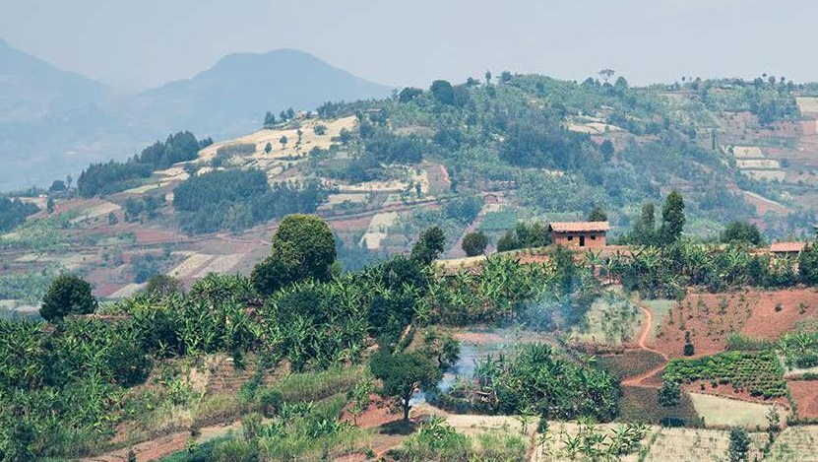
Comprehensive Multi hazard Risk Assessment in Malawi
Multi-Hazard Risk Assessment Project
Roberto Rudari
CIMA Research Foundation

Slide 2



Comprehensive Multi hazard Risk Assessment in Malawi
MOTIVATION
The Risk Assessment at national and district scale will inform: Policies, strategies, investments & development plans, emergency plans, risk financing, mitigation and adaptation actions…
GEOGRAPHICAL SCOPE
Consistent and comparable analysis at National scale with a detail tha can be used down to the district level
DELIVERABLES
Risk Assessment Metodology
Risk Atlas
Training

Slide 3



Comprehensive Multi hazard Risk Assessment in Malawi
The Partership
PROJECT COORDINATION
CLIMATE-RELATED HAZARDS RISK ASSESSMENT
DISSEMINATION AND TRAINING
DISSEMINATION PLATFORM
EXPOSURE AND VULNERABILTY ASSESSMENT
EARTHQUAKE RISK ASSESSMENT
DISSEMINATION PLATFORM
GIS DATABASE
LANDSLIDE RISK ASSESSMENT
DATA COLLECTION
DISSEMINATION AND TRAINING
RISK ATLAS TUNING AND VALIDATION

Slide 4
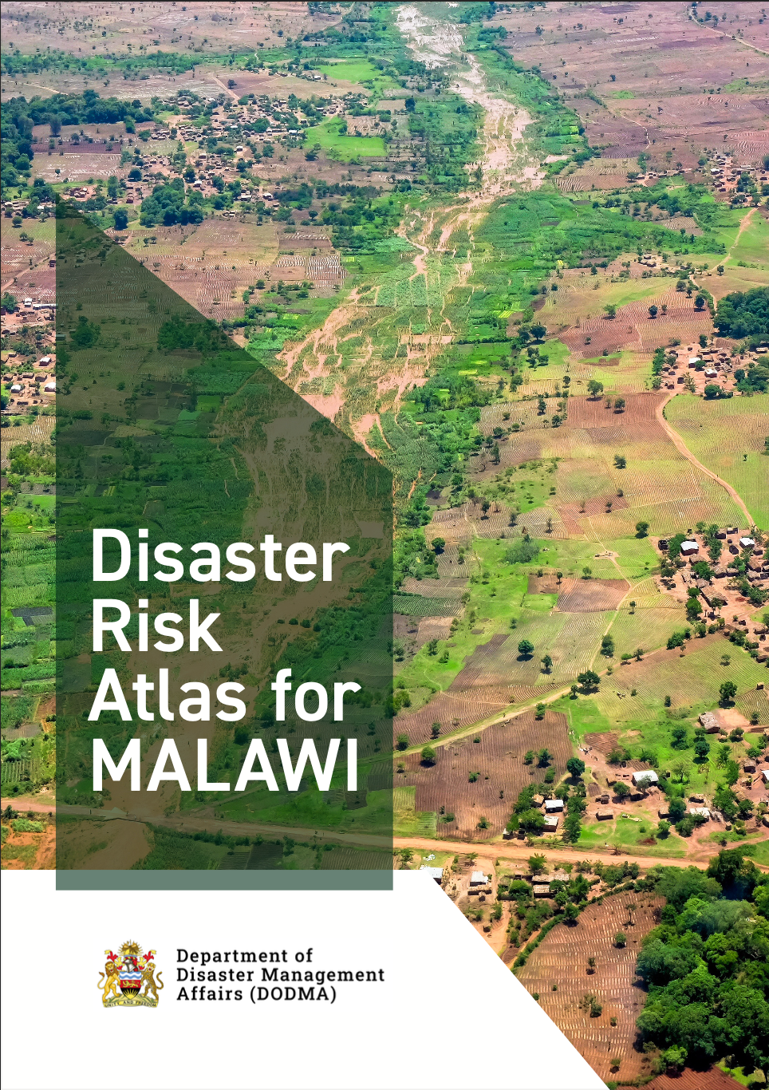
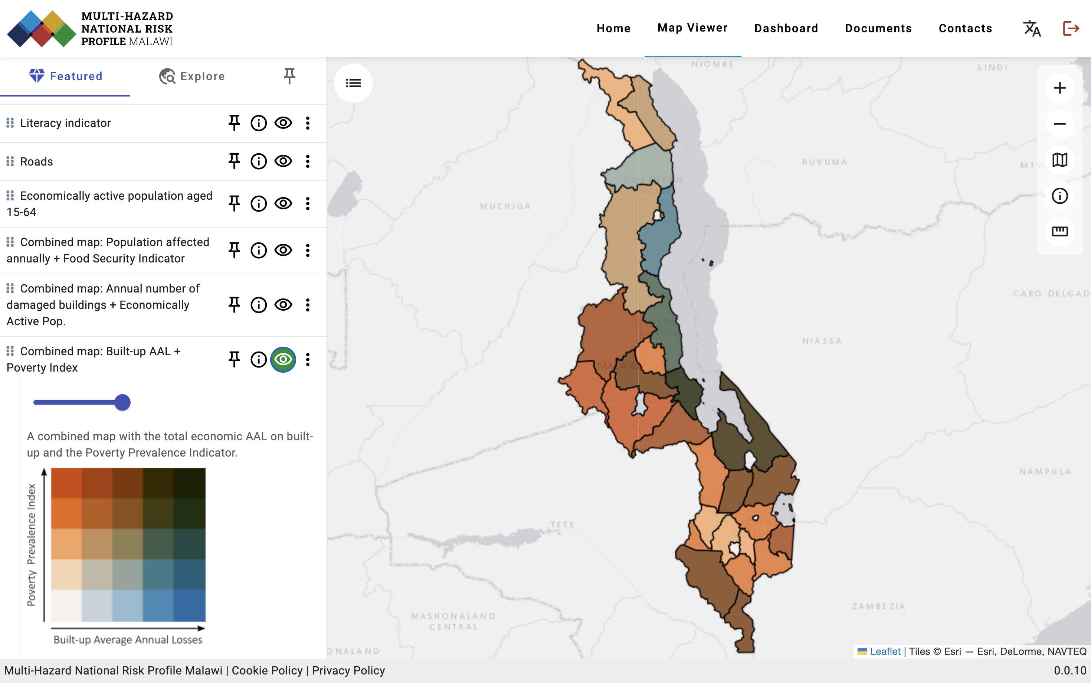
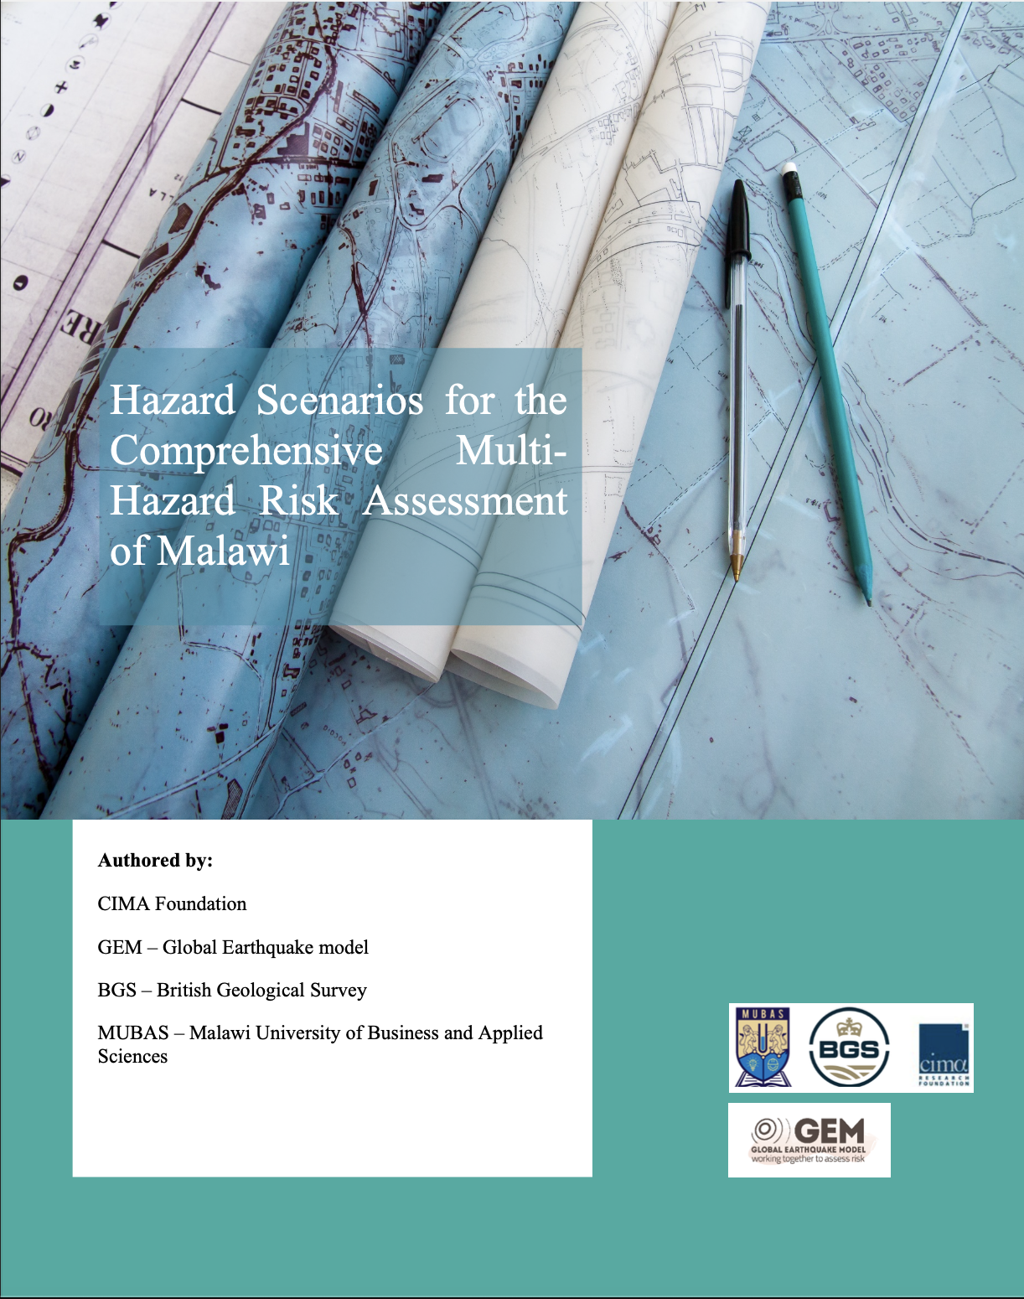
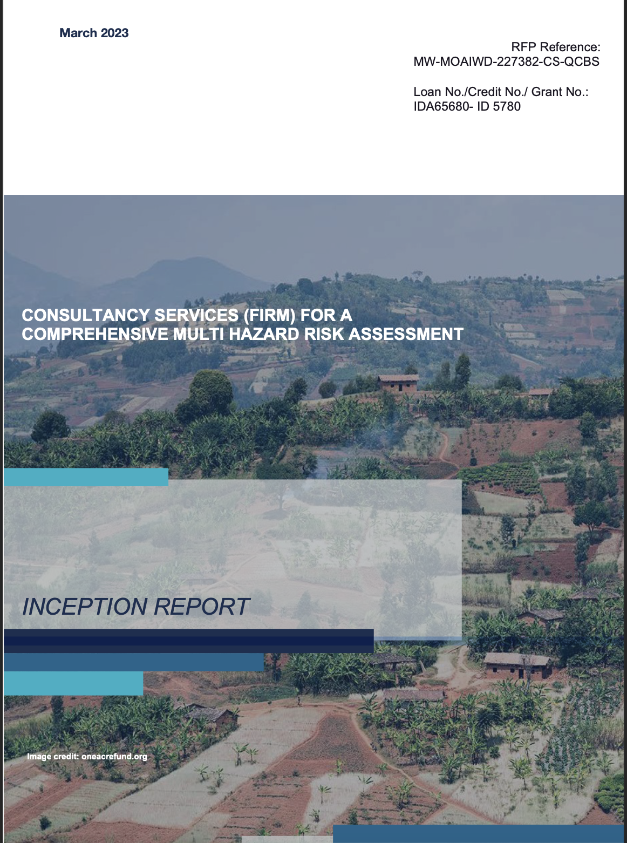

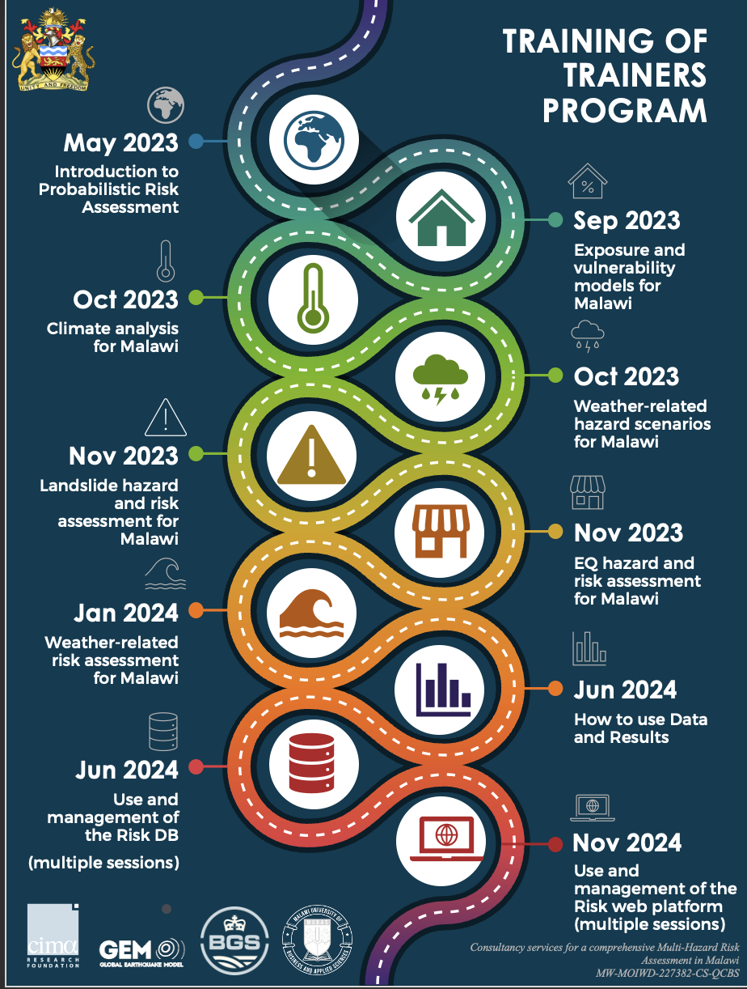
Comprehensive Multi hazard Risk Assessment in Malawi
HAZARD ASSESSMENT
EXPOSURE ASSESSMENT
RA Platform
RISK ASSESSMENT
DATA COLLECTION AND METHODOLOGY CONSOLIDATION
VULNERABILITY ASSESSMENT
DB
CAPACITY DEVELOPMENT & TRAINING

Slide 5
Methodology and Risk Metrics
Comprehensive Multi hazard Risk Assessment in Malawi
Risk is too often based on qualitative perception
Needs for data and objective methodology
for risk quantification

Slide 6
RA Methods
Comprehensive Multi hazard Risk Assessment in Malawi
Fully Probabilistic Risk Assessment
Historical assessement
Topical Scenario Based
Quantitative Semiquantitative Qualitative

Slide 7
Comprehensive Multi hazard Risk Assessment in Malawi
Historical events
Observed losses
100
75
Loss (K USD)
50
Average
25
5
10
15
20
25
Time (years)

Slide 8
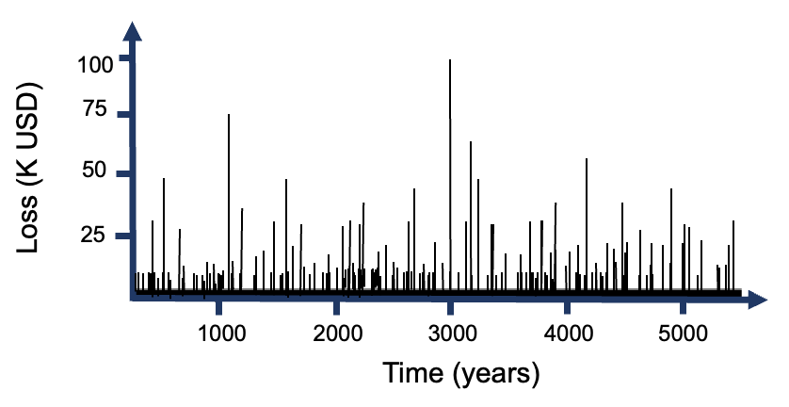
Comprehensive Multi hazard Risk Assessment in Malawi
Probabilistic Risk Assessment
(all possible events)
Simulation (numerical modelling) of a large number of possible scenarios
Average Annual Loss

Slide 9
Comprehensive Multi hazard Risk Assessment in Malawi
Uncertainty
Adapted from RMS
There are two main sources of Uncertainty:
Primary uncertainty (including sampling variability) concerns the event generation component of the model – INCLUDES the CLIMATE CHANGE Aspect
Secondary uncertainty: the uncertainty in the amount of loss, given that a certain event has occurred.

Slide 10
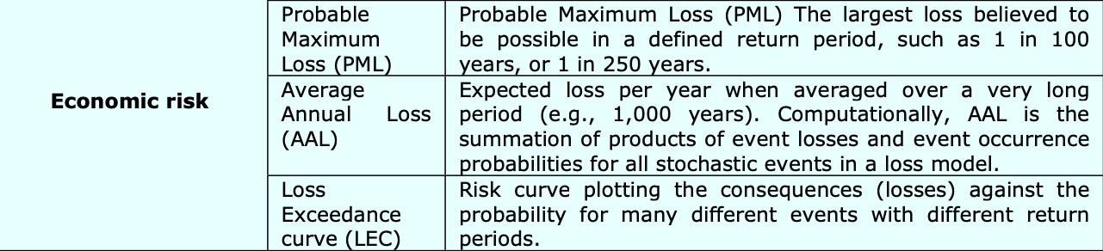
Risk Metrics
Comprehensive Multi hazard Risk Assessment in Malawi
Risk profiling allows to evaluate the total risk and to quantify of the expected losses in monetary values over a specific period of time, using appropriate risk metrics.
Loss Exceedance Curve (LEC)
Risk curve plotting the annual frequency with which a loss, usually expressed in monetary units, can be equaled or exceeded.
van Westen et al., Multi-hazard risk assessment, Distance education course, Guide Book

Slide 11
Comprehensive Multi hazard Risk Assessment in Malawi
Loss exceedance curve (LEC)
Represents the anual frequency of loss value is exceeded
Non-extreme events
High frequency: Retrospective análisis
Loss exceednce rate
(#/year)
Loss (monetary units)

Slide 12
Comprehensive Multi hazard Risk Assessment in Malawi
Loss exceedance curve (LEC)
Represents the anual frequency of loss value is exceeded
Loss exceedance rate
(#/year)
Extreme events
Low frequency: Prospective analysis
Loss (monetary units)

Slide 13
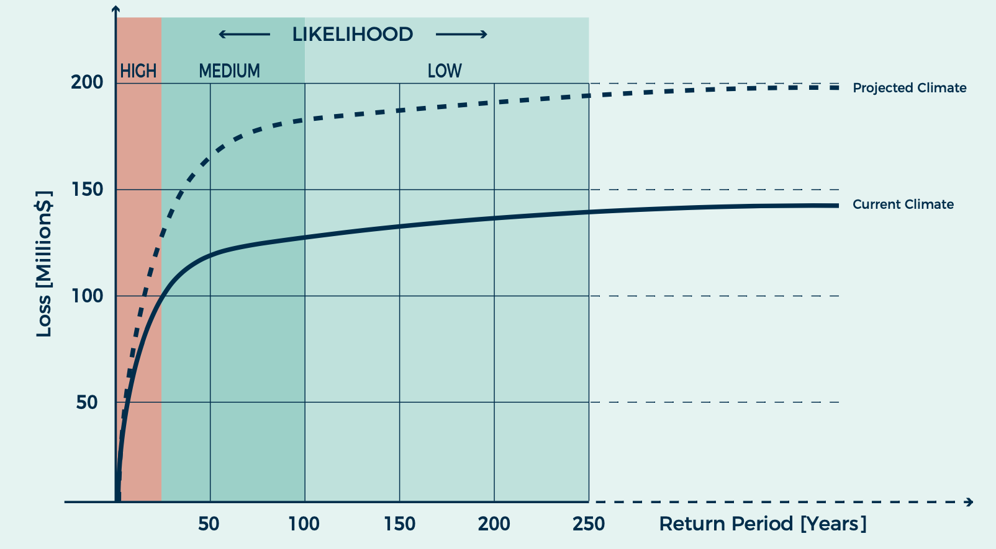
Comprehensive Multi hazard Risk Assessment in Malawi
Probabilistic Risk Assessment
(all possible events)
PML curve

Slide 14
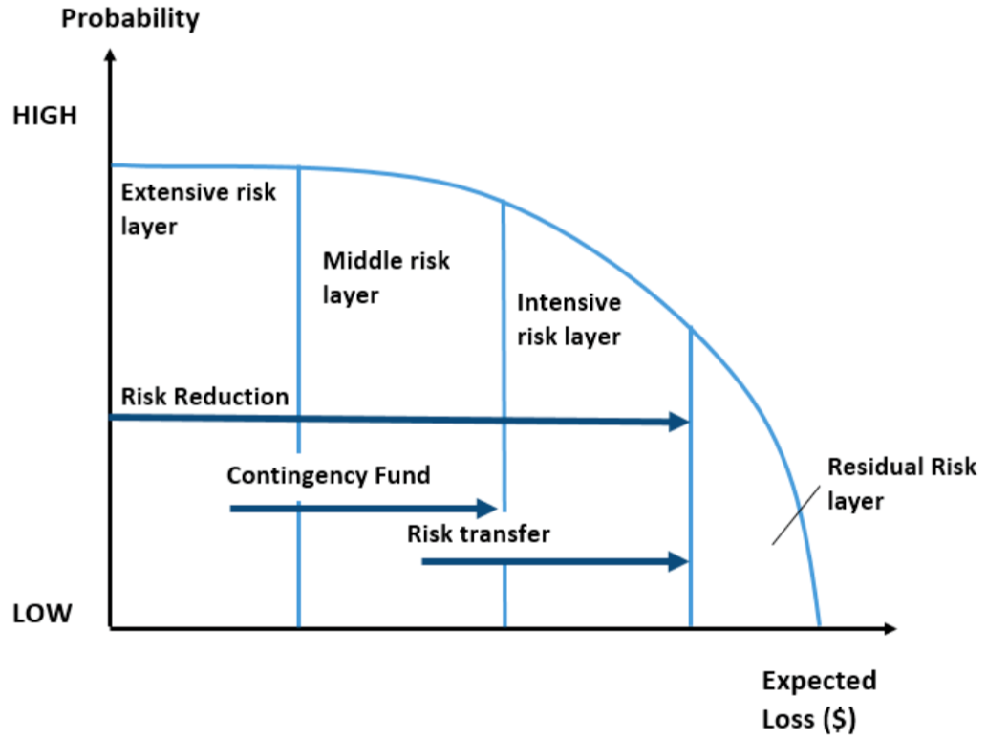
What is the use of PML Curves and AALs?

Slide 15
SOCIO-ECONOMIC
VULNERABILITY

Slide 16





Hazards considered
RIVERINE AND PLUVIAL FLOODING
STRONG WINDS
DROUGHTS
LANDSLIDES
(EQ & Rainfall triggered)
EARTHQUAKES

Slide 17
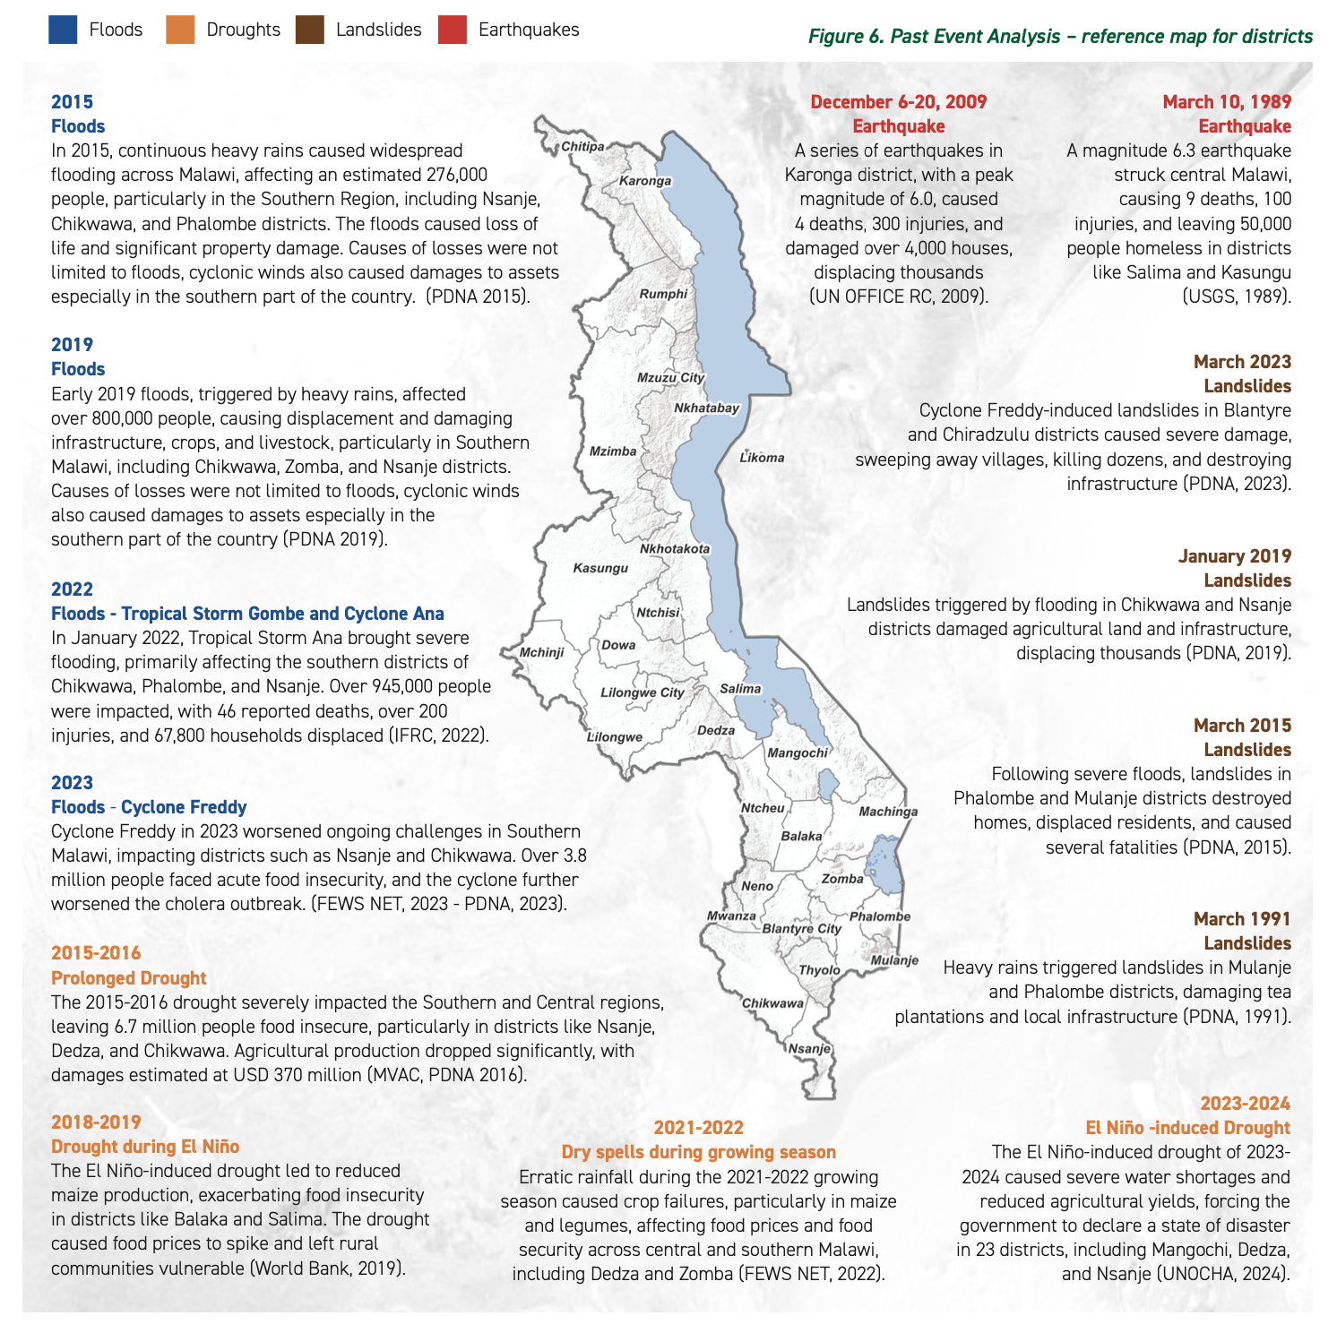
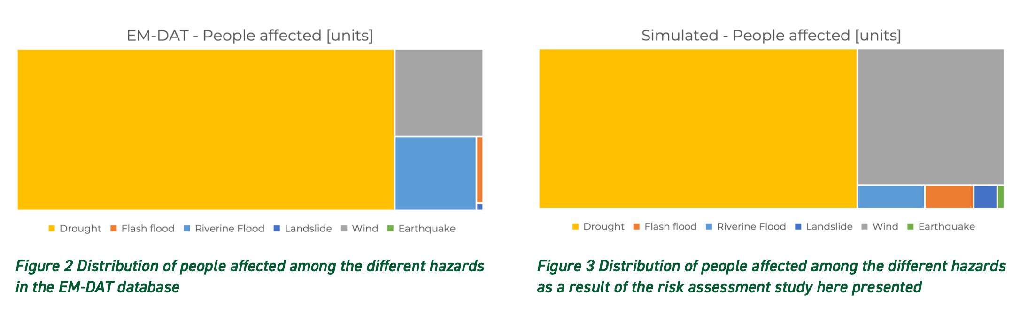
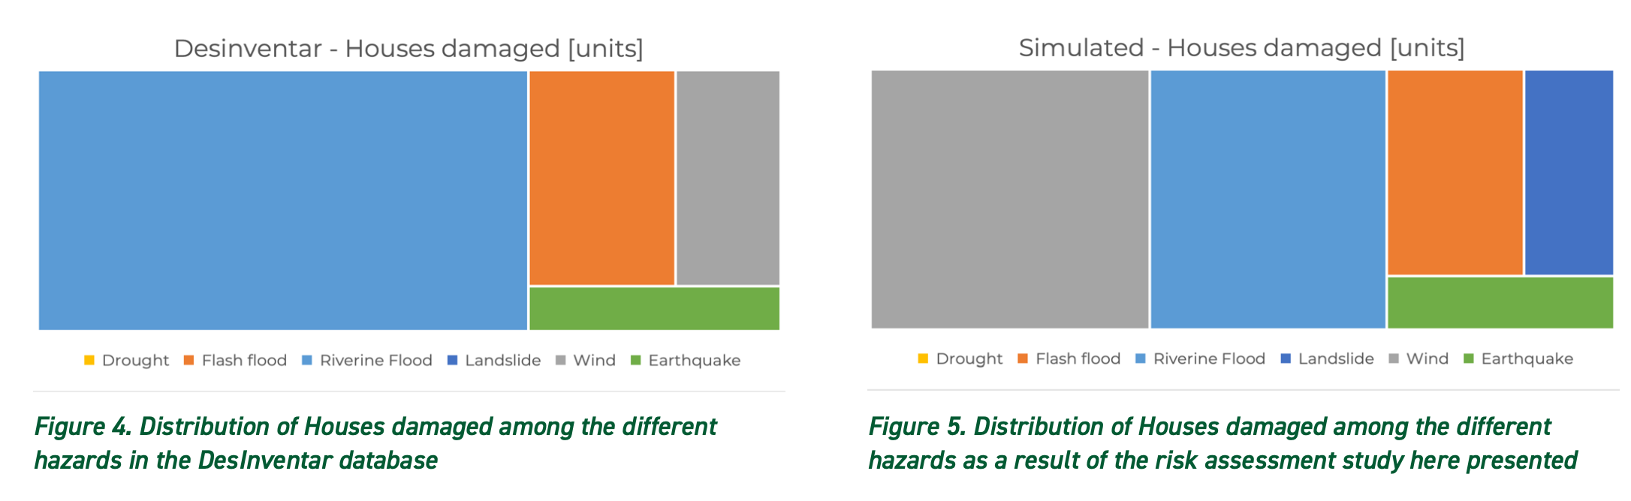
Historical Analysis

Slide 18
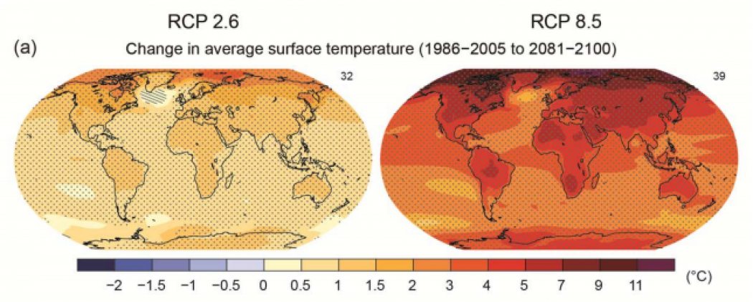
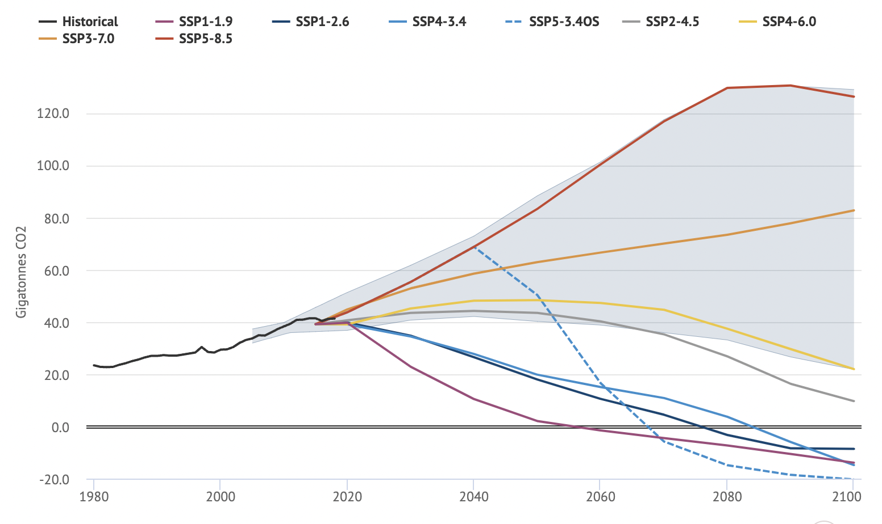
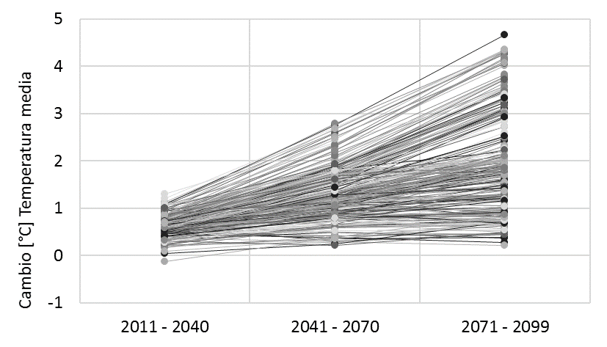
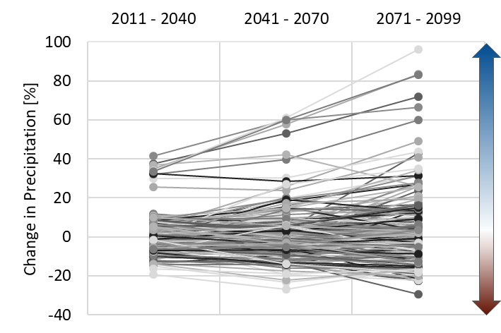






A common Climate dataset
Comprehensive Multi hazard Risk Assessment in Malawi
Global Circulation Model
49 GCM
RCP 2.6
RCP 8.5
Change in temperature for 2100
Representative Concentration Pathways
$$+$$
Socioeconomic
Shared
Pathways
ISIMIP3 Dataset
$$∆P$$
Change in Temperature
Change in Precipitation
$$∆T$$
Set of time-dependent, physically consistent variations of meteorological inputs
$$∆RH$$
$$∆G$$
$$…$$
For example: 311 projections

Slide 19


A common Climate dataset
Comprehensive Multi hazard Risk Assessment in Malawi
$$∆T$$
Change in Temperature
Change in Precipitation
$$∆P$$

Slide 20


A common Climate dataset
Comprehensive Multi hazard Risk Assessment in Malawi
$$∆T$$
$$∆T$$
Model bounds
Change in Temperature
Change in Precipitation
$$∆P$$
$$∆P$$

Slide 21
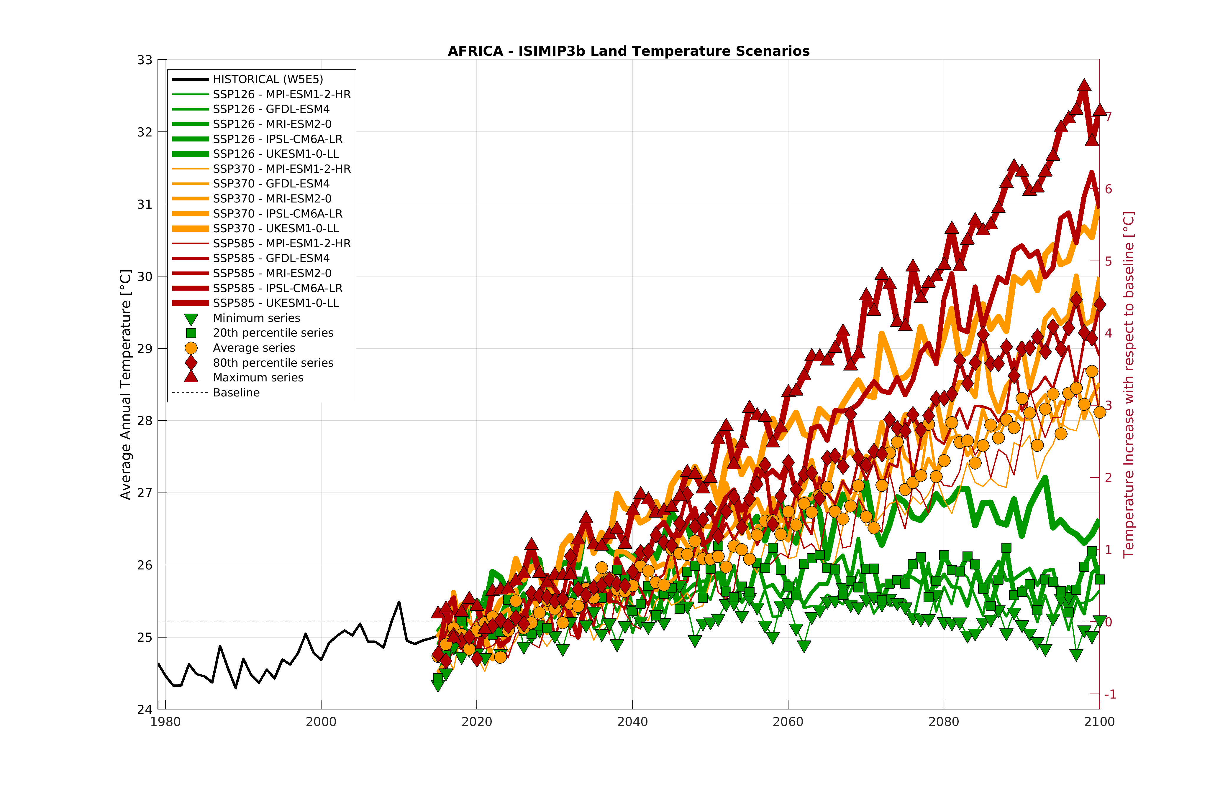
A common Framework
Comprehensive Multi hazard Risk Assessment in Malawi
Climate scenarios analysis
20% percentiole: SSP126 – IPSL-CM6A-LR
80% percentiole: SSP585 - IPSL-CM6A-LR

Slide 22
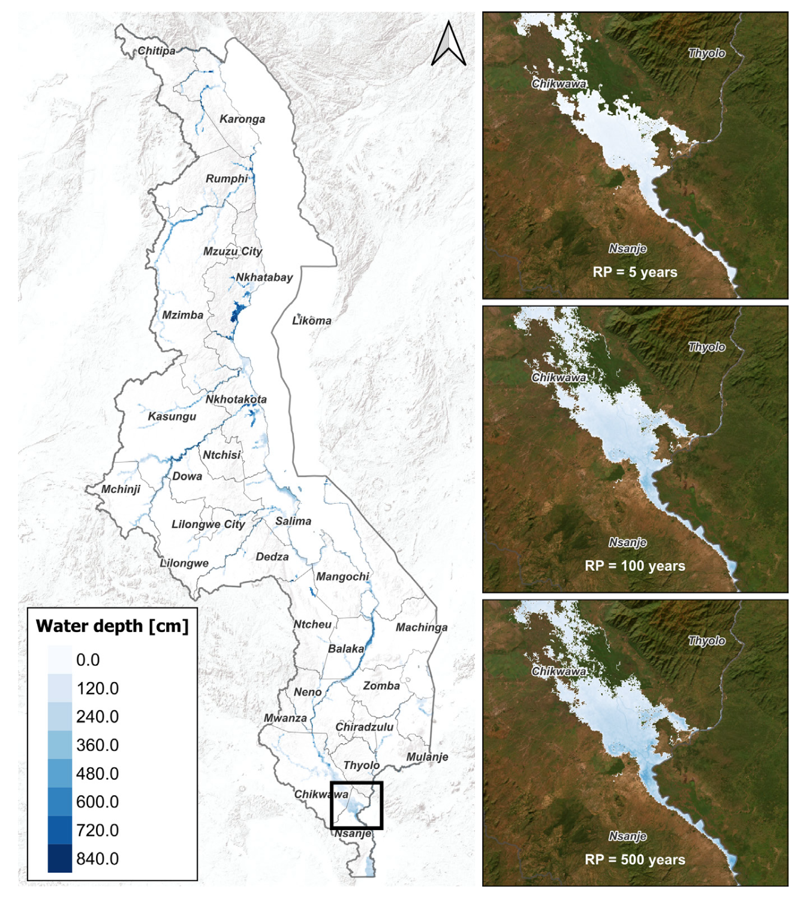
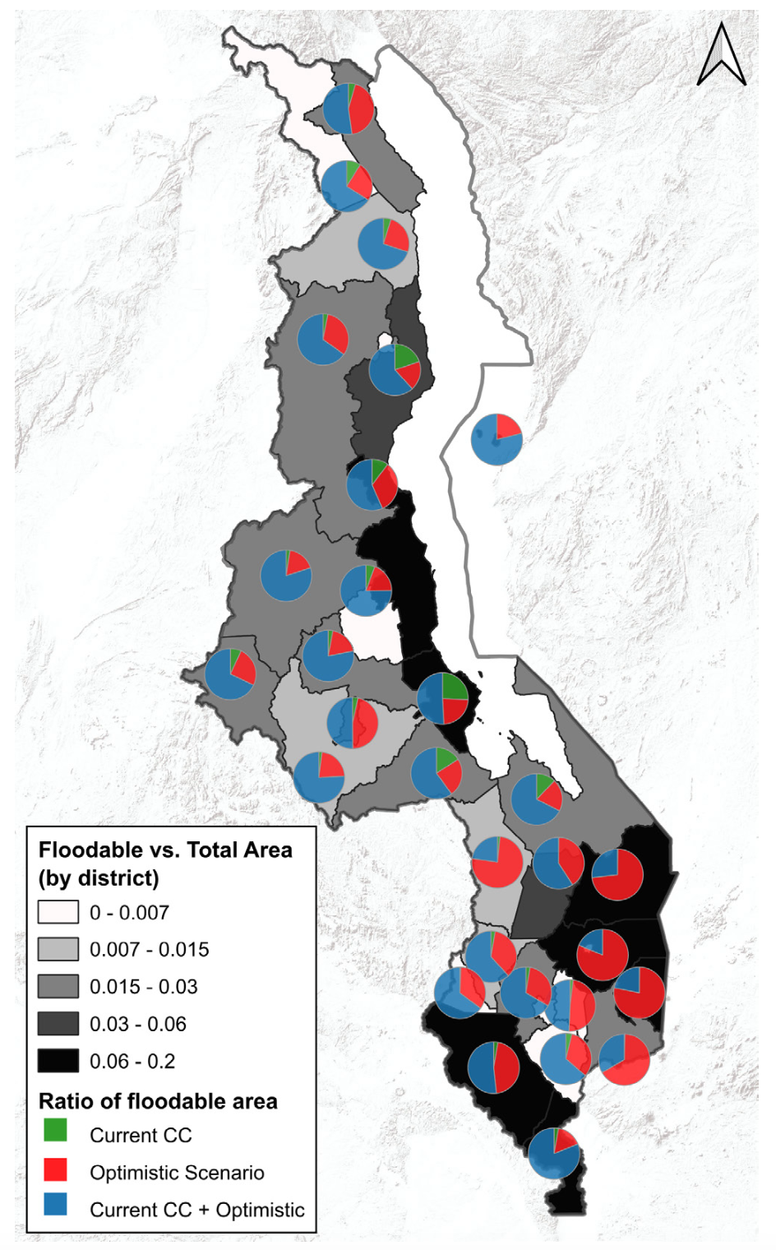
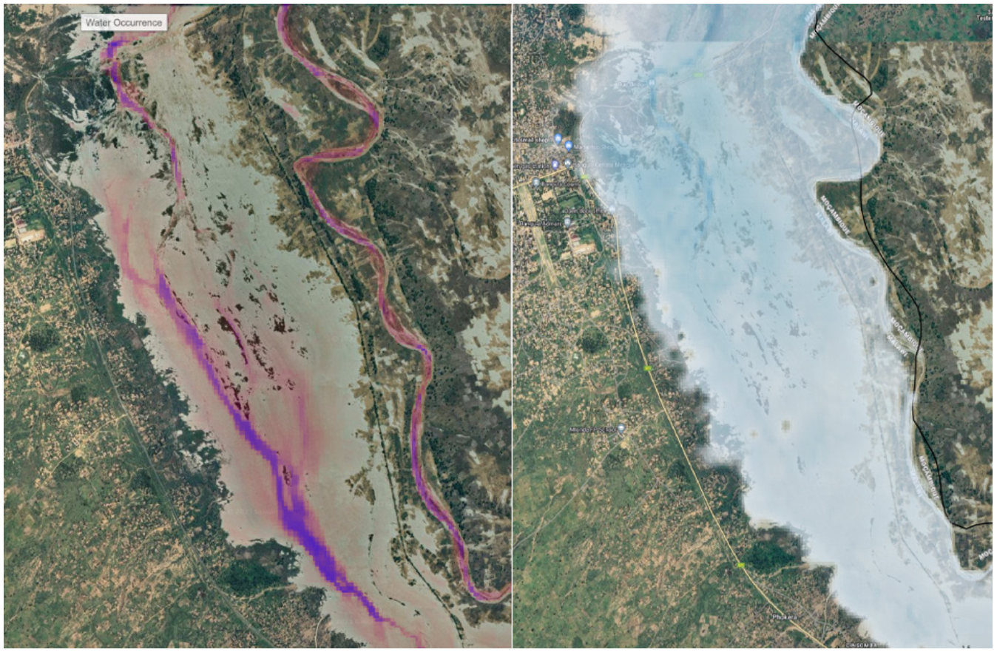
Riverine Flood Hazard Assessment
100 RPs maps from 2 to 100 year
Present and Climate projections
Validated with satellite data

Slide 23
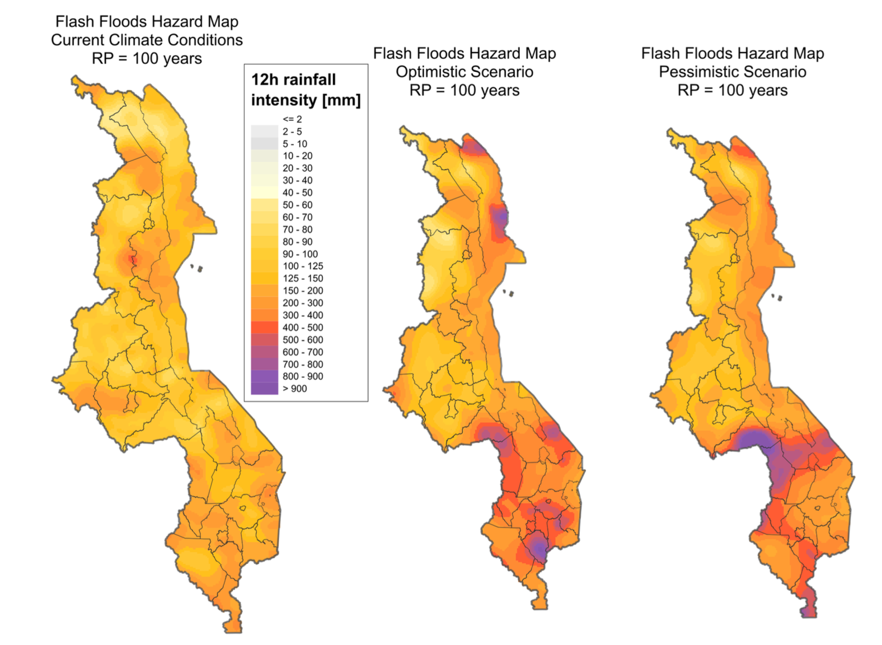
Flash Floods Hazard Assessment
Rainfall intensity on durations from 1 to 24 hour
Several return periods
Bias corrected and disaggregated at 2km
Present and climate scenarios

Slide 24
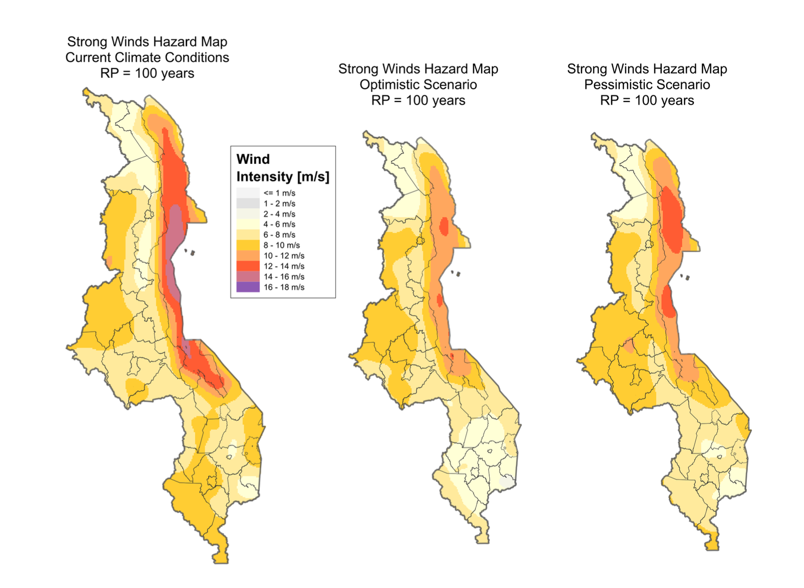
Strong Winds Hazard Assessment
Max Wind intensity in 1 hour
Several return periods
Bias corrected and disaggregated at 2km
Present and climate scenarios

Slide 25
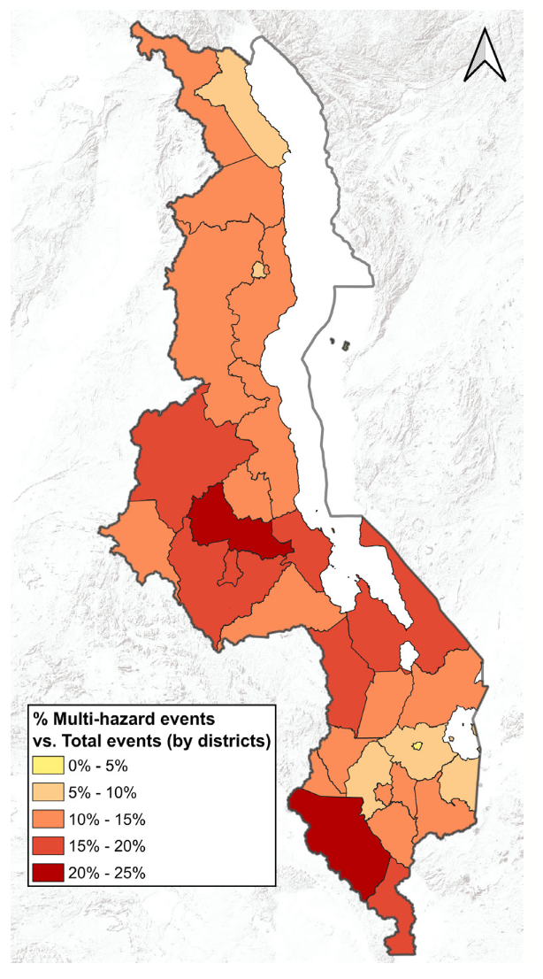
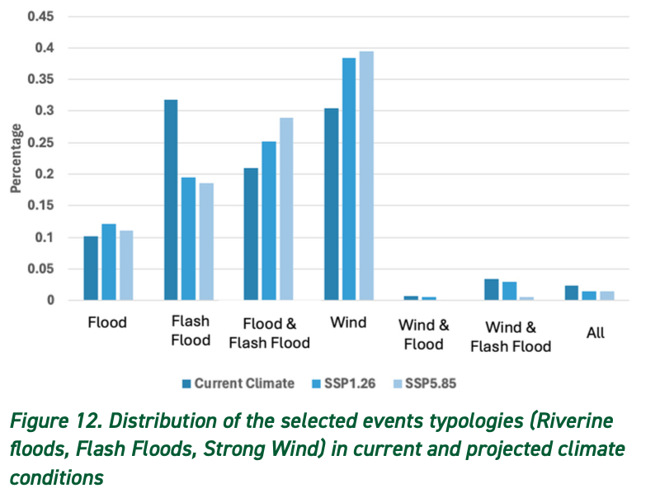
Fast-Onset Wether compound Hazard Assessment
Combined riverine flash floods and strog wind events
Present and climate scenarios

Slide 26
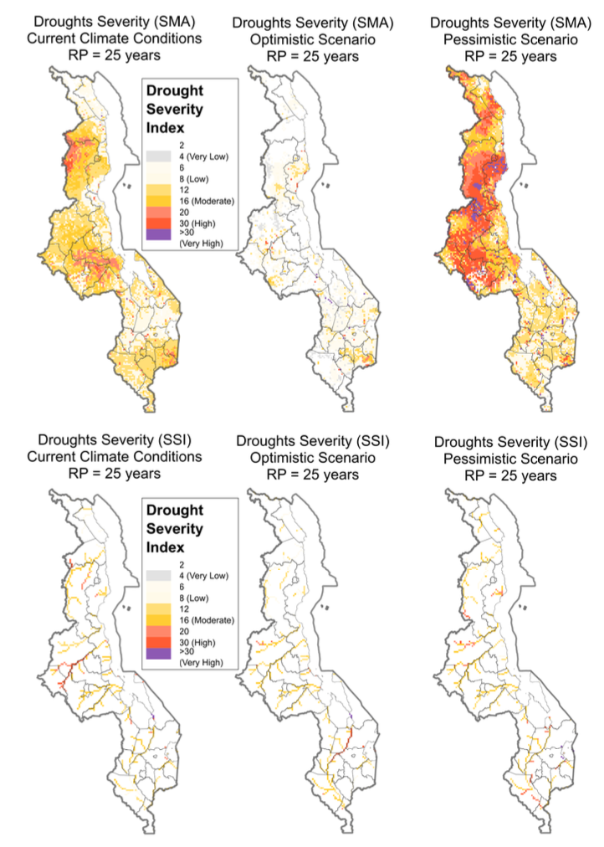
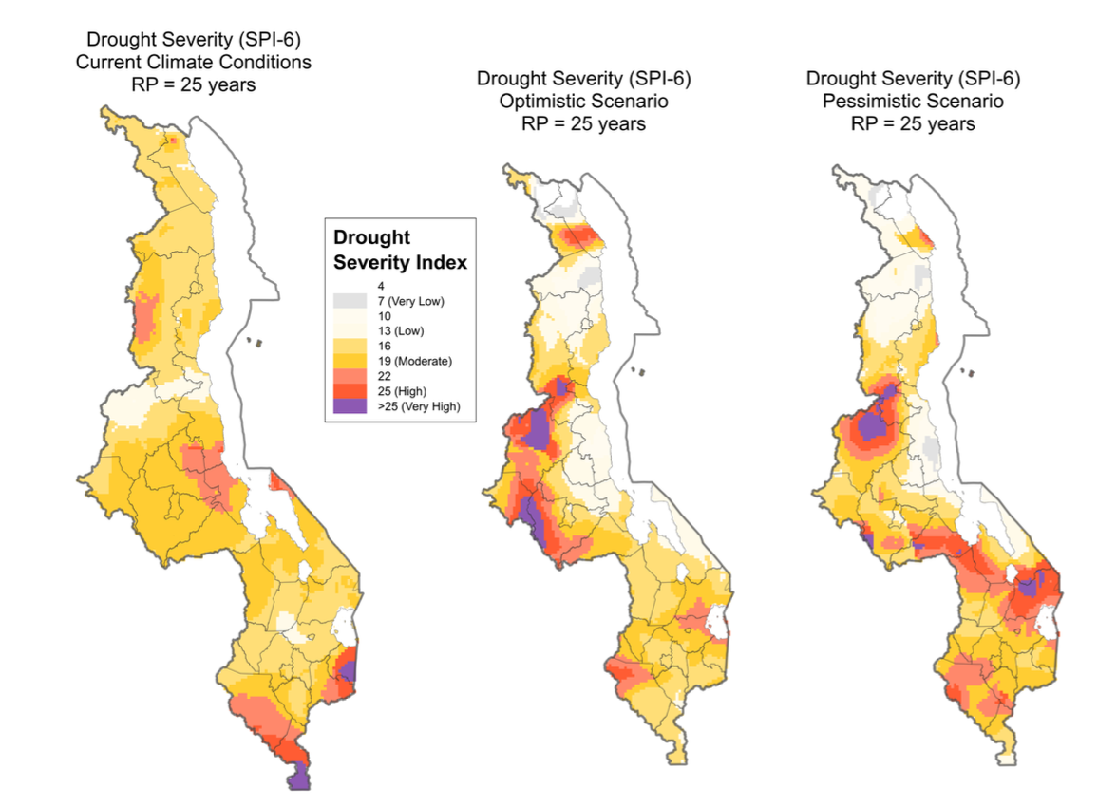
Drought Hazard Assessment
SPI, SMA, SSI considered
Several return periods
Present and climate scenarios

Slide 27
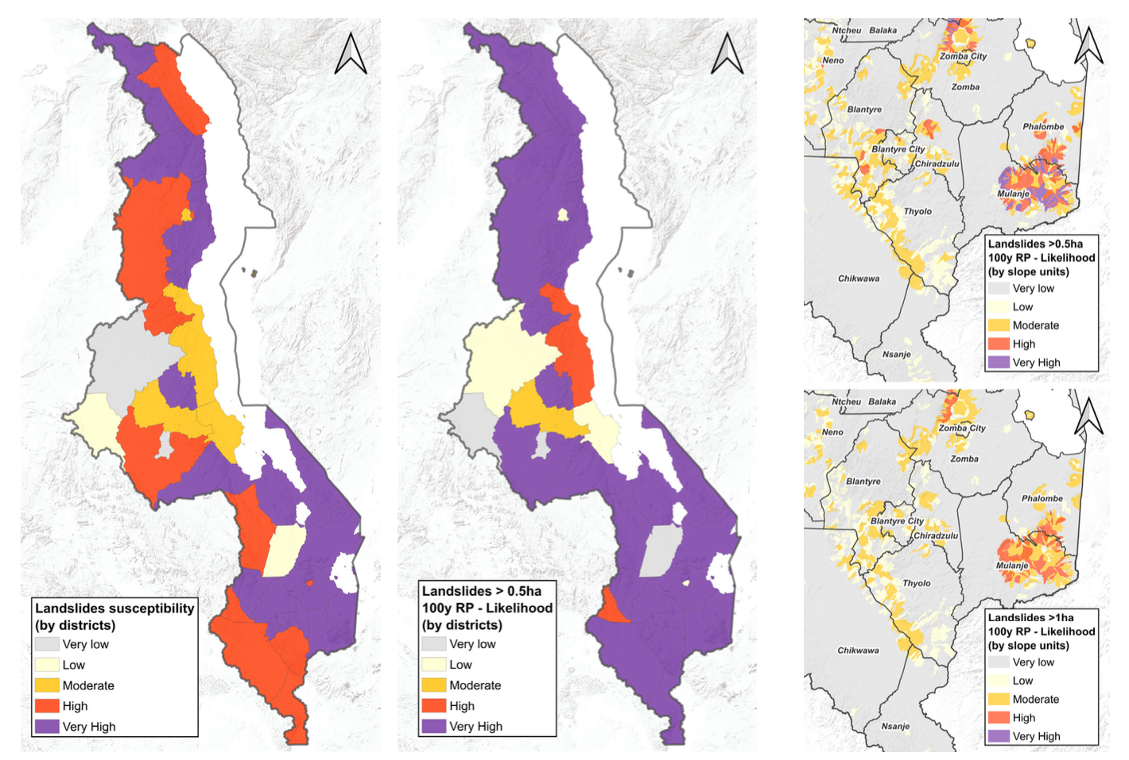
Landslides Hazard Assessment
Susceptivity combining geomorphological, soil and climatic factors
Several return periods
Large and small landslides considered

Slide 28
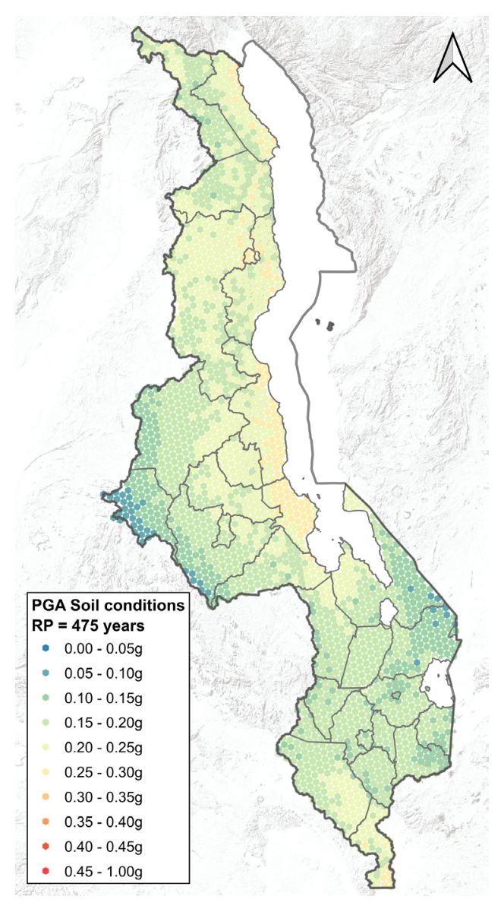
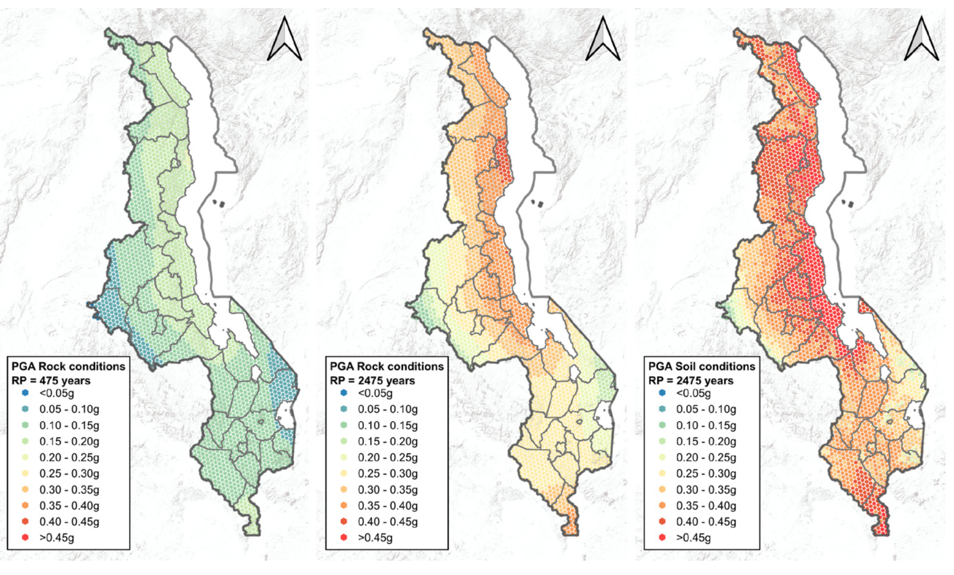
Earthquakes Hazard Assessment
Different soil conditions
Different Return Periods

Slide 29
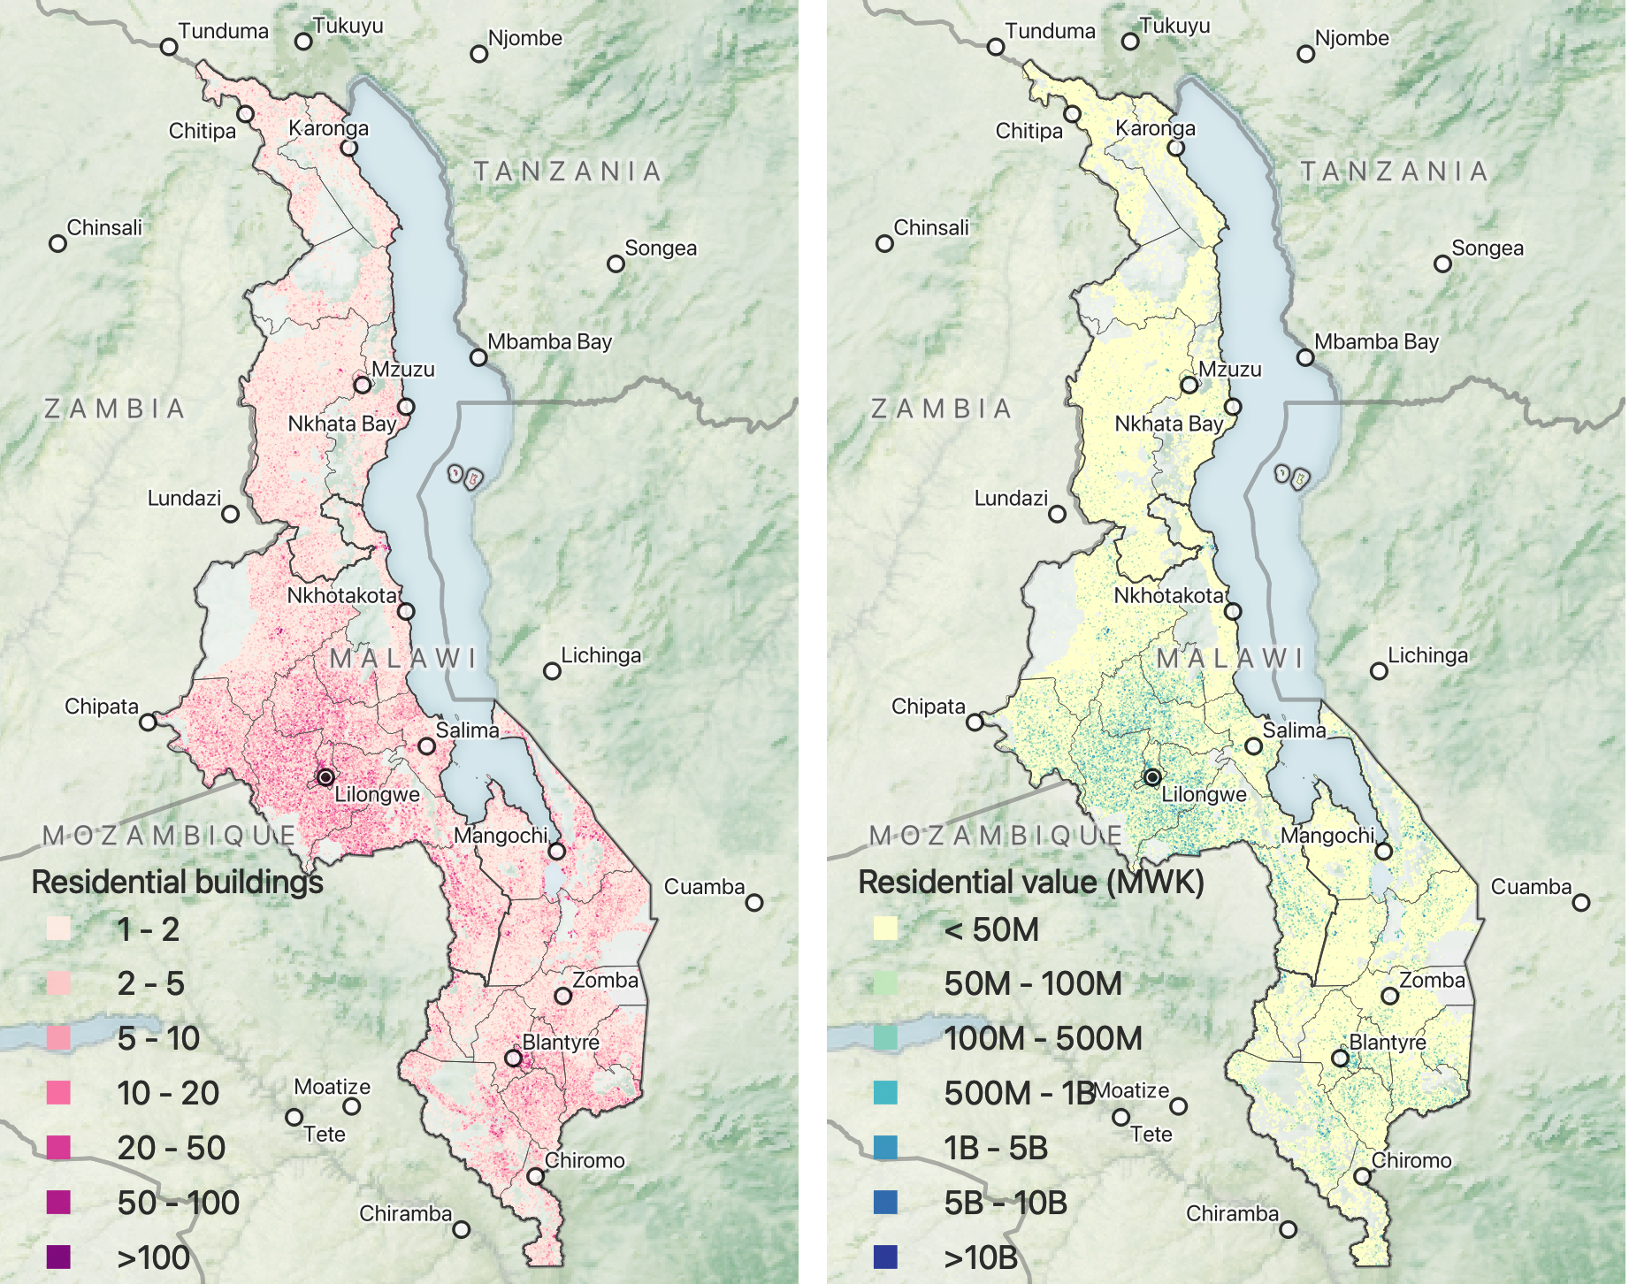
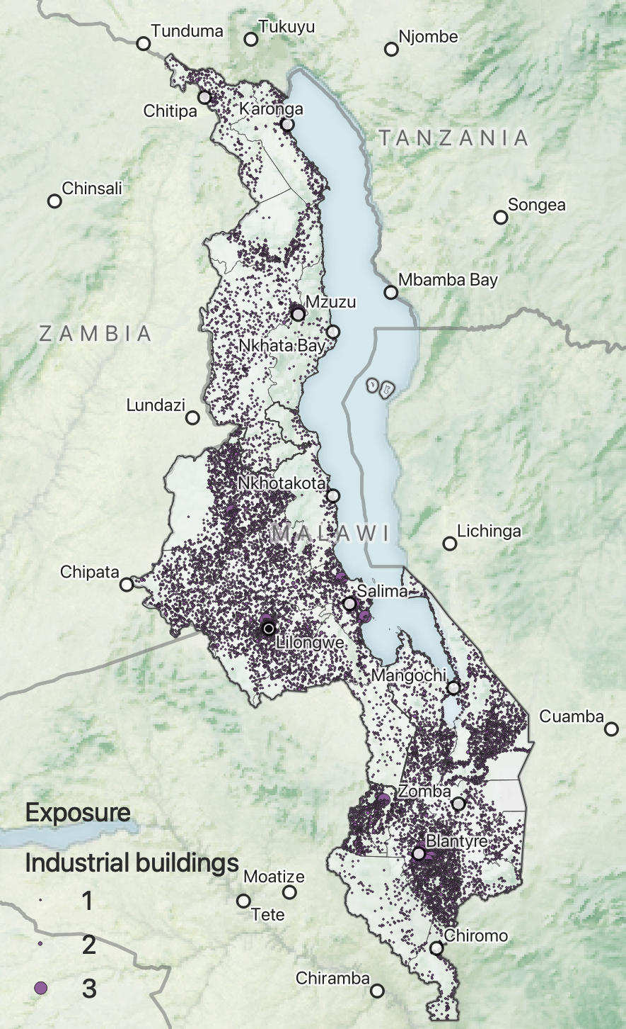
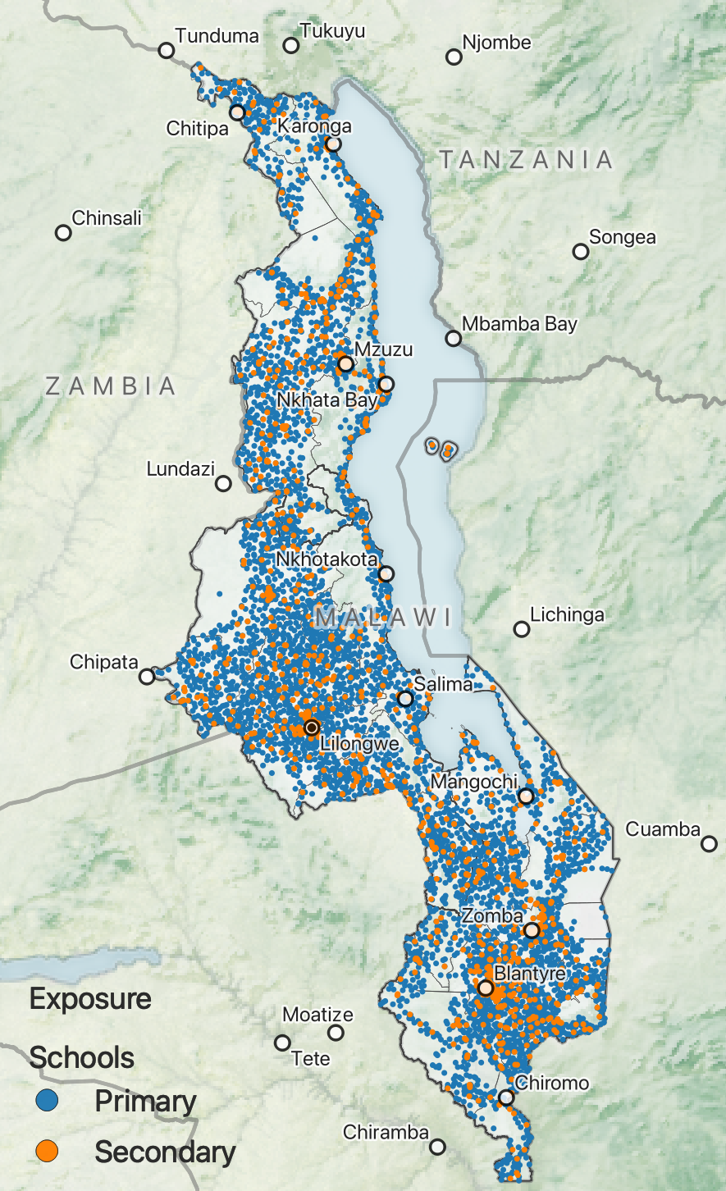

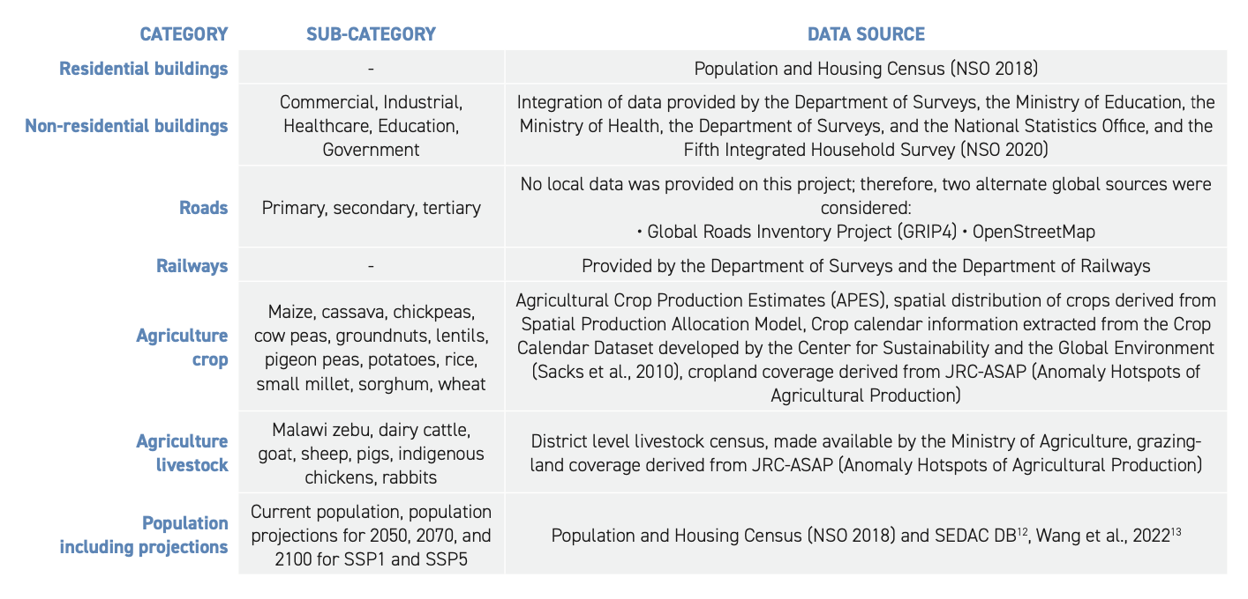
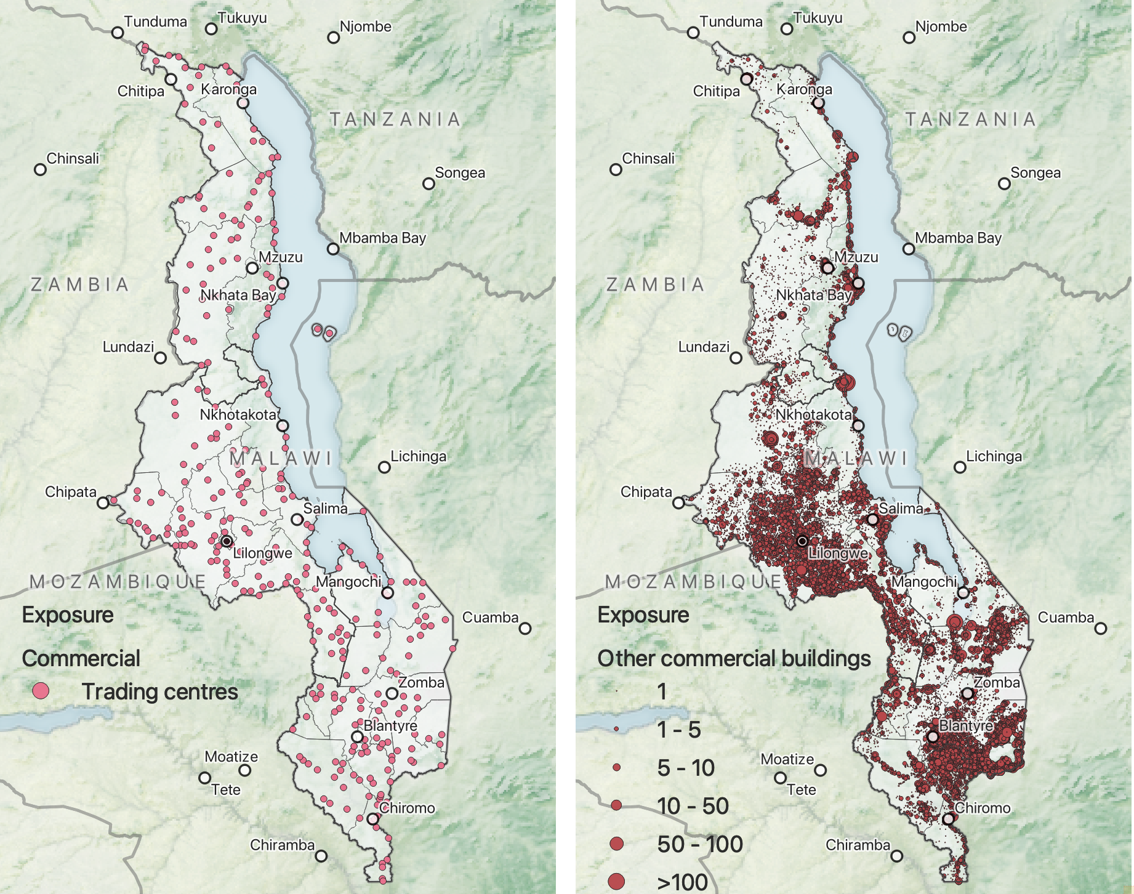
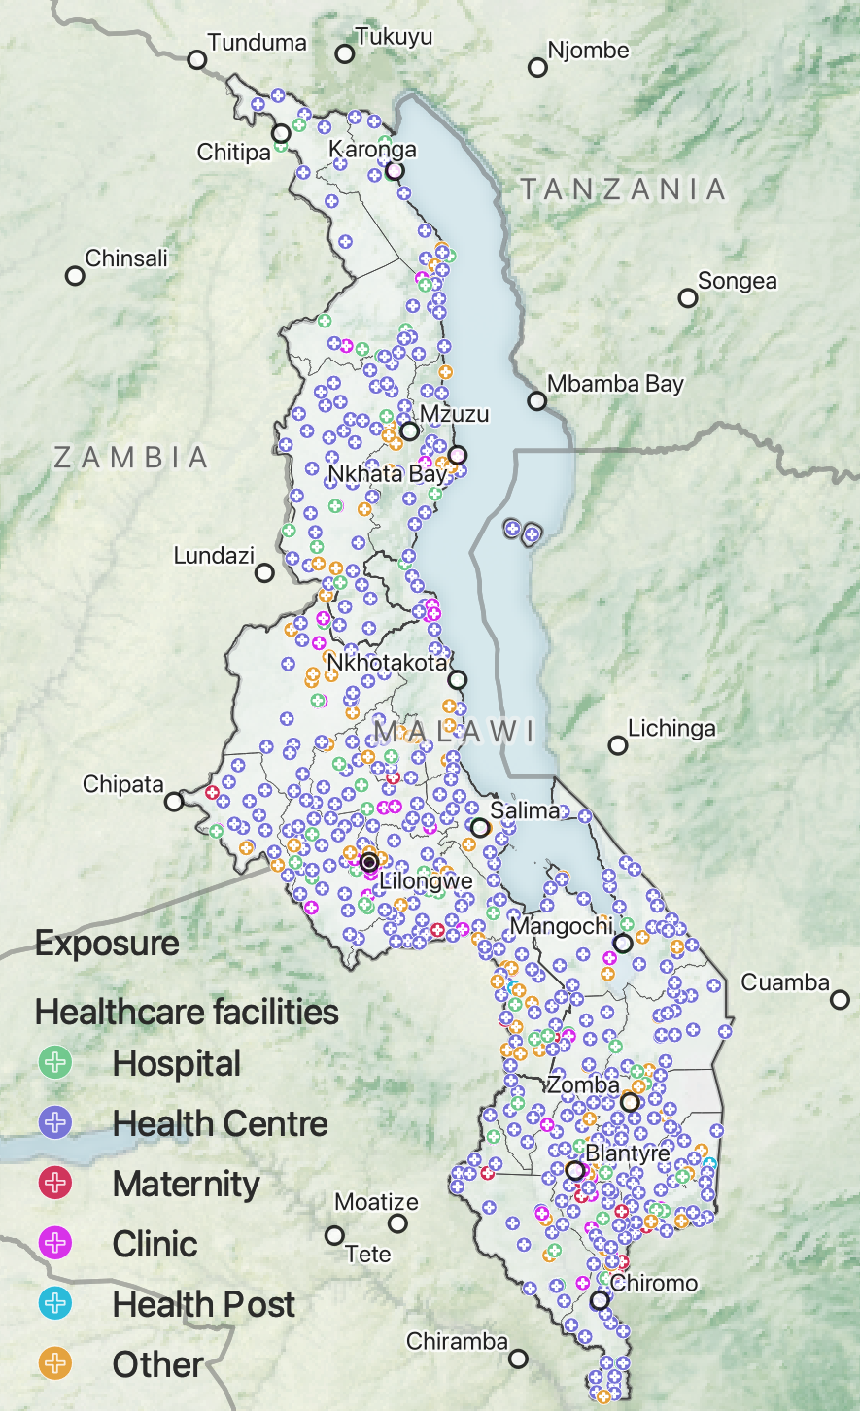
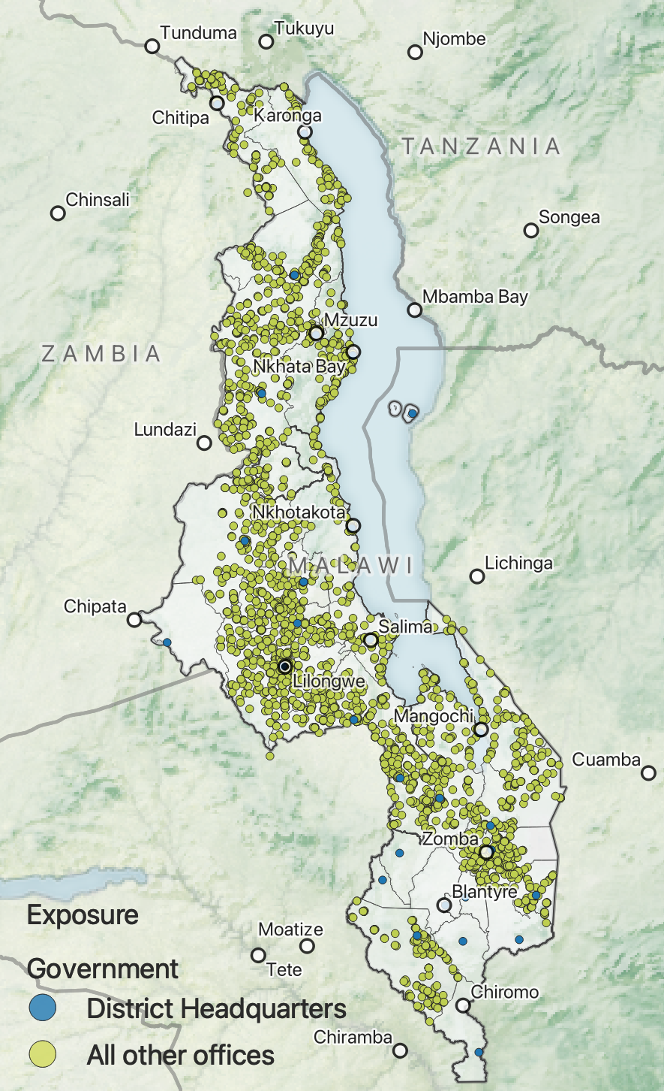
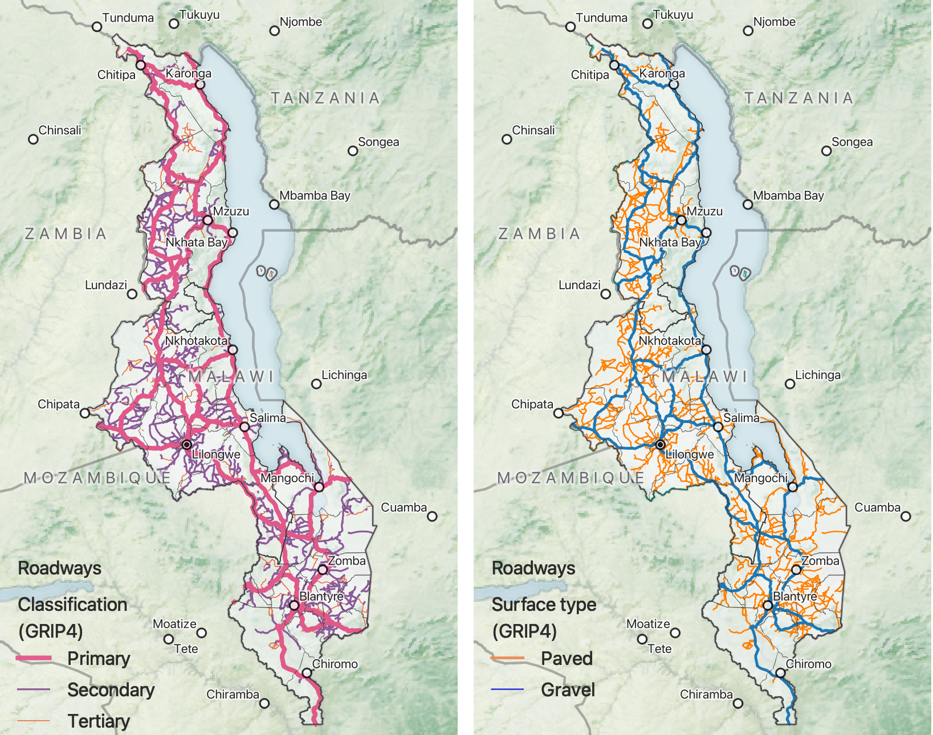
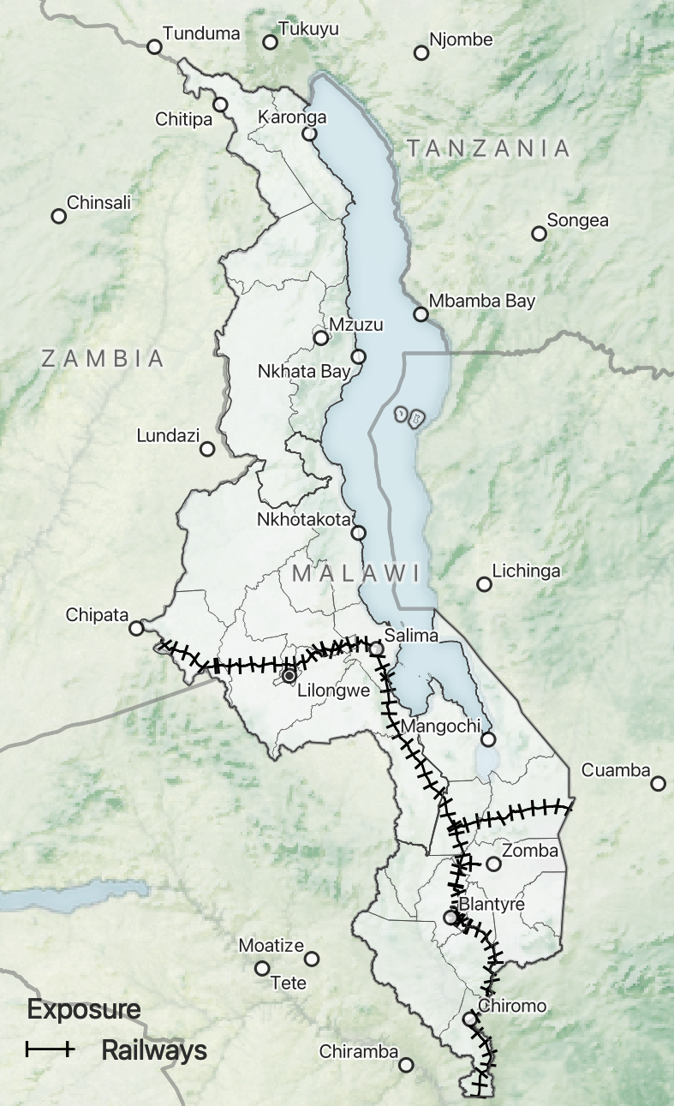
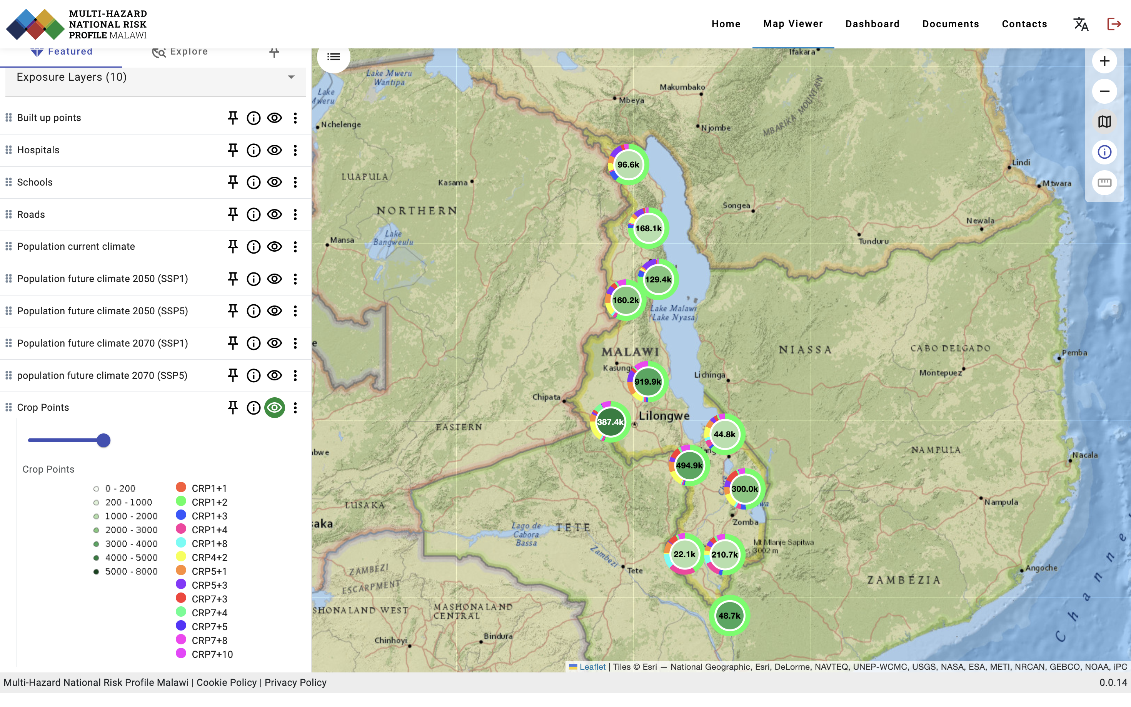
Exposure
Residential BLDs
Industrial BLDs
Edu BLDs
Population
Powered by:
Commercial BLDs
Health BLDs
Govnt BLDs
Roads
Railways
Agriculture
Homogenised, Quality controlled Global, Regional and National data

Slide 30
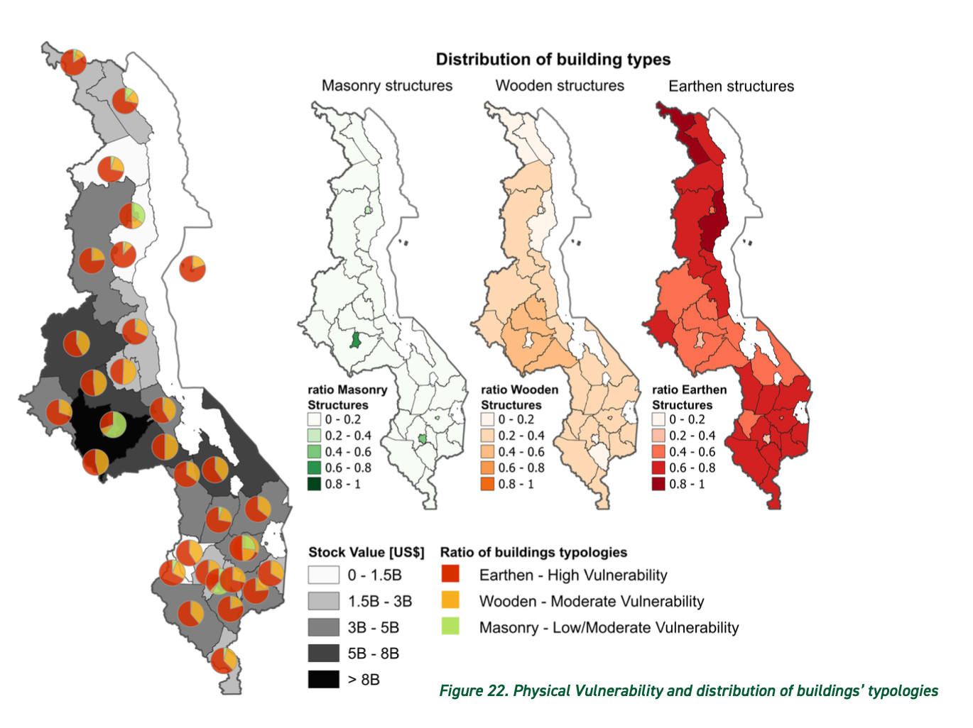
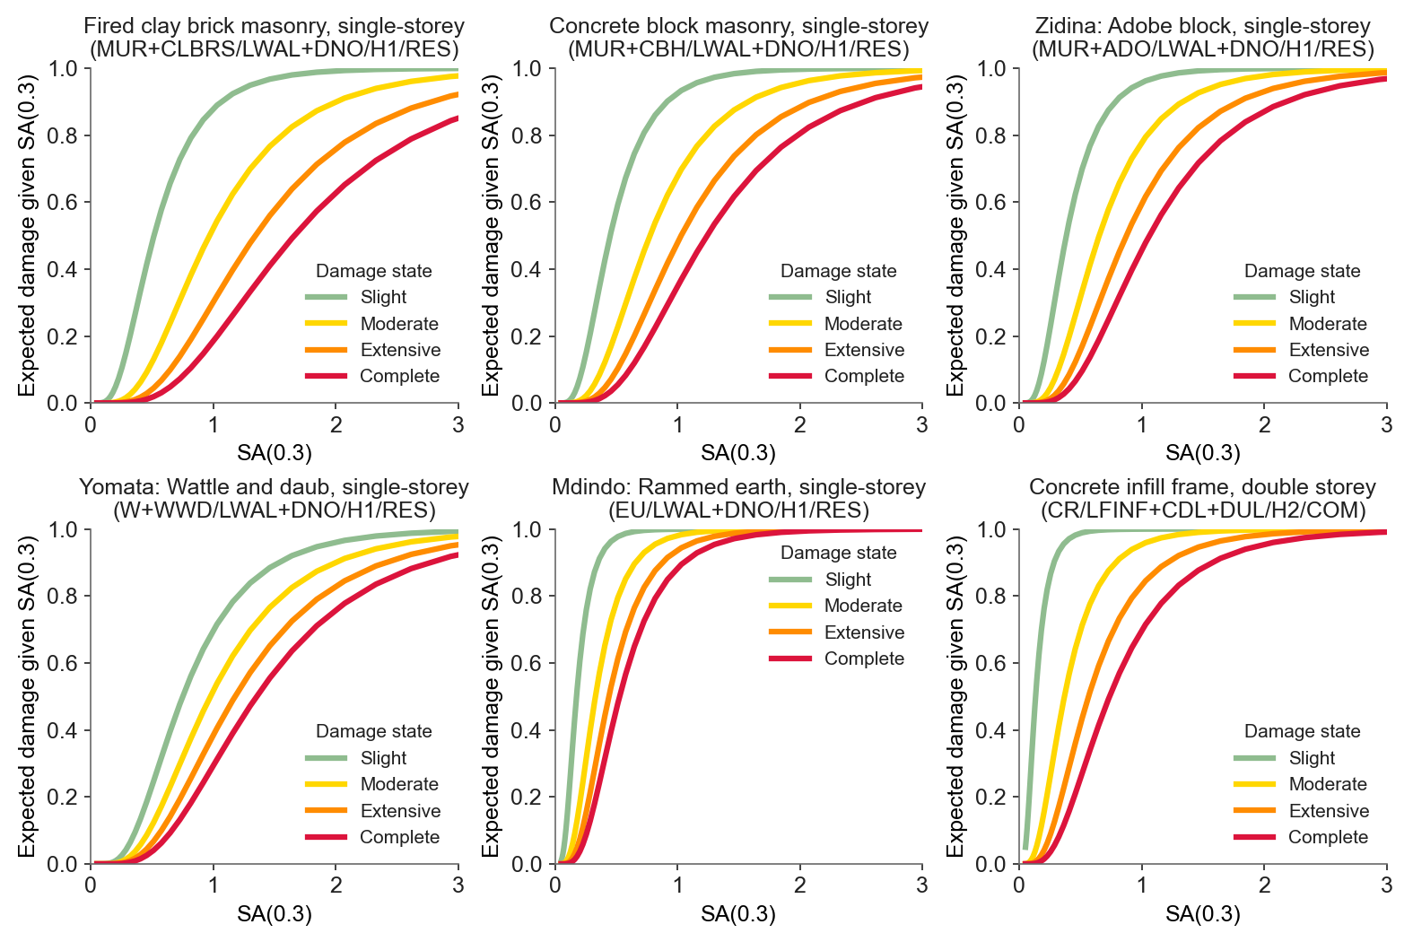
Physical Vulnerability
The Basis for each PRA
Specialised Vlunerability curves, Fragility curves and Indexes for each one of the Hazard and for each one of the exposure assets

Slide 31
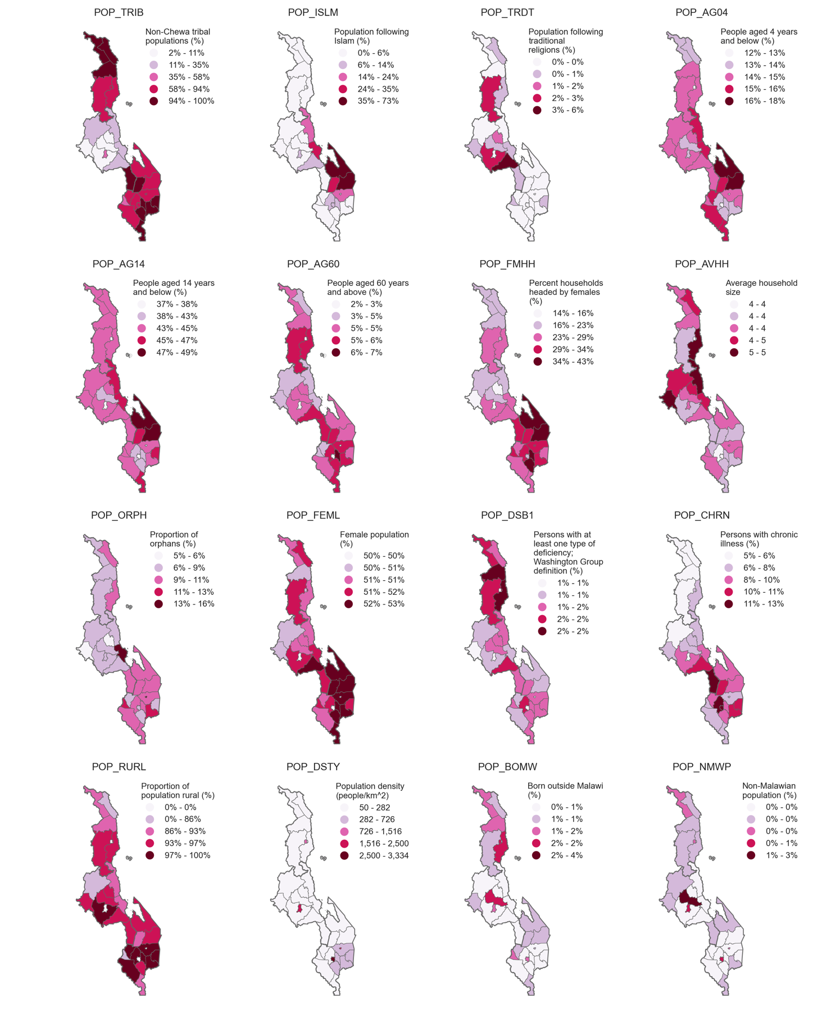
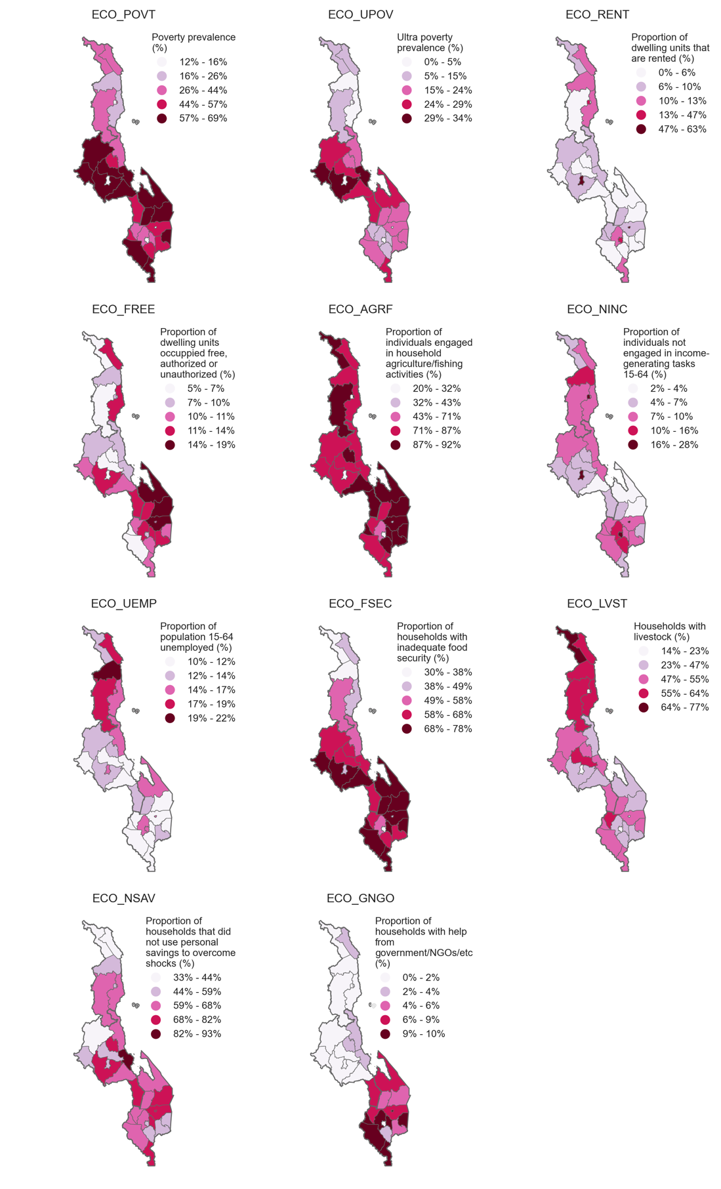
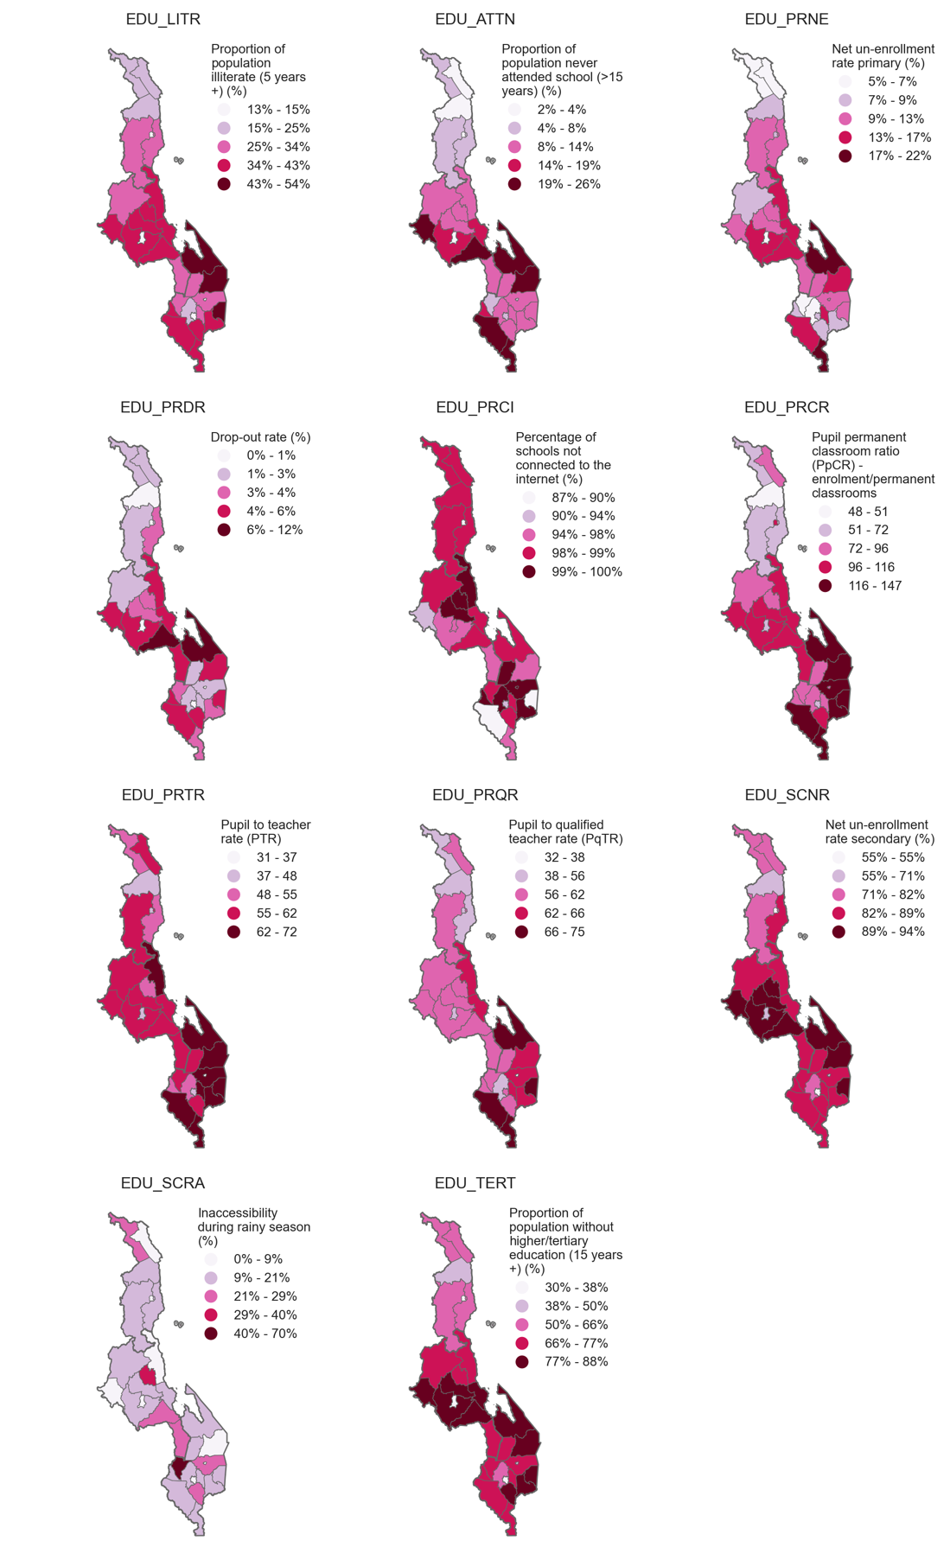
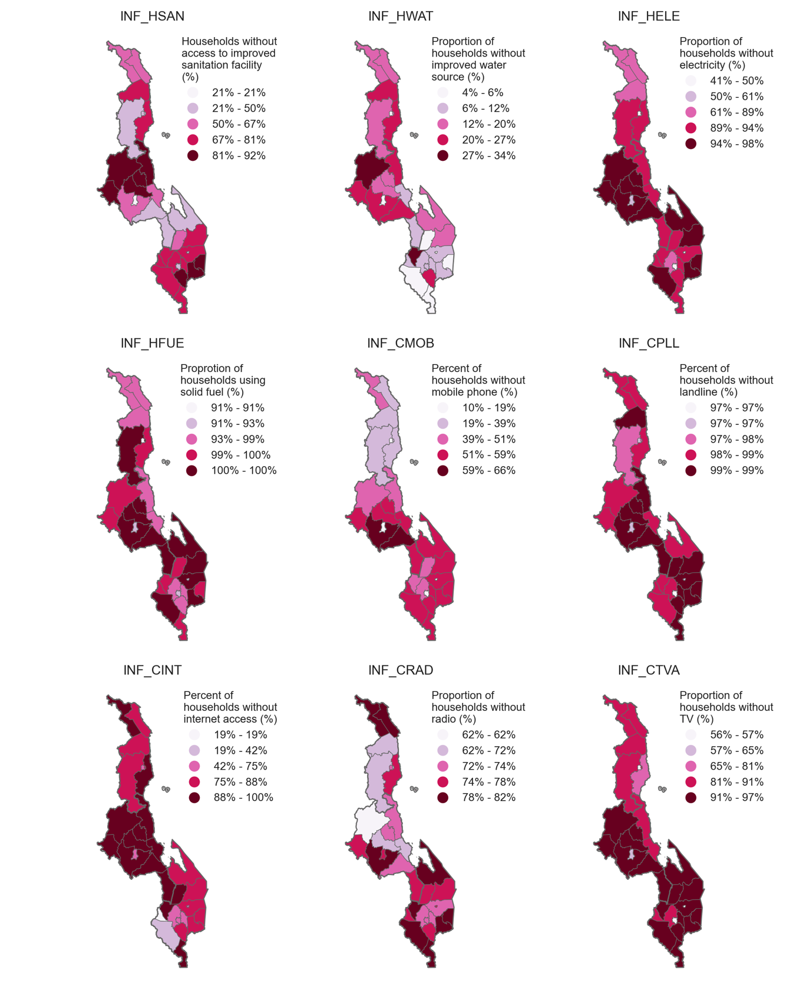
Socio-Economic Vulnerability
POP: Demography
ECO: Economy
EDU: Education
INF: Information
Multi-dimensional analysis

Slide 32
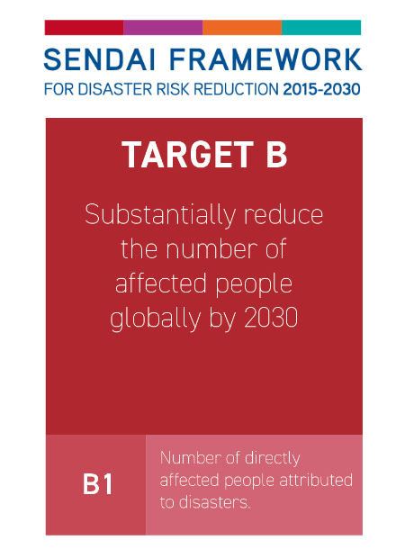
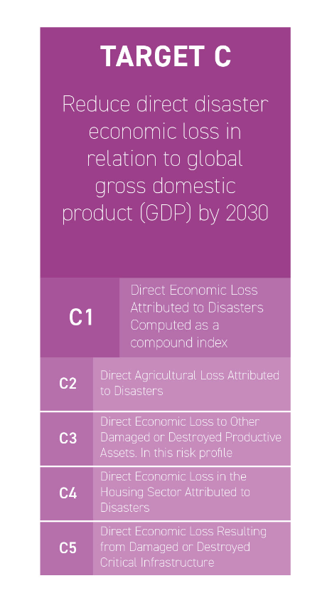
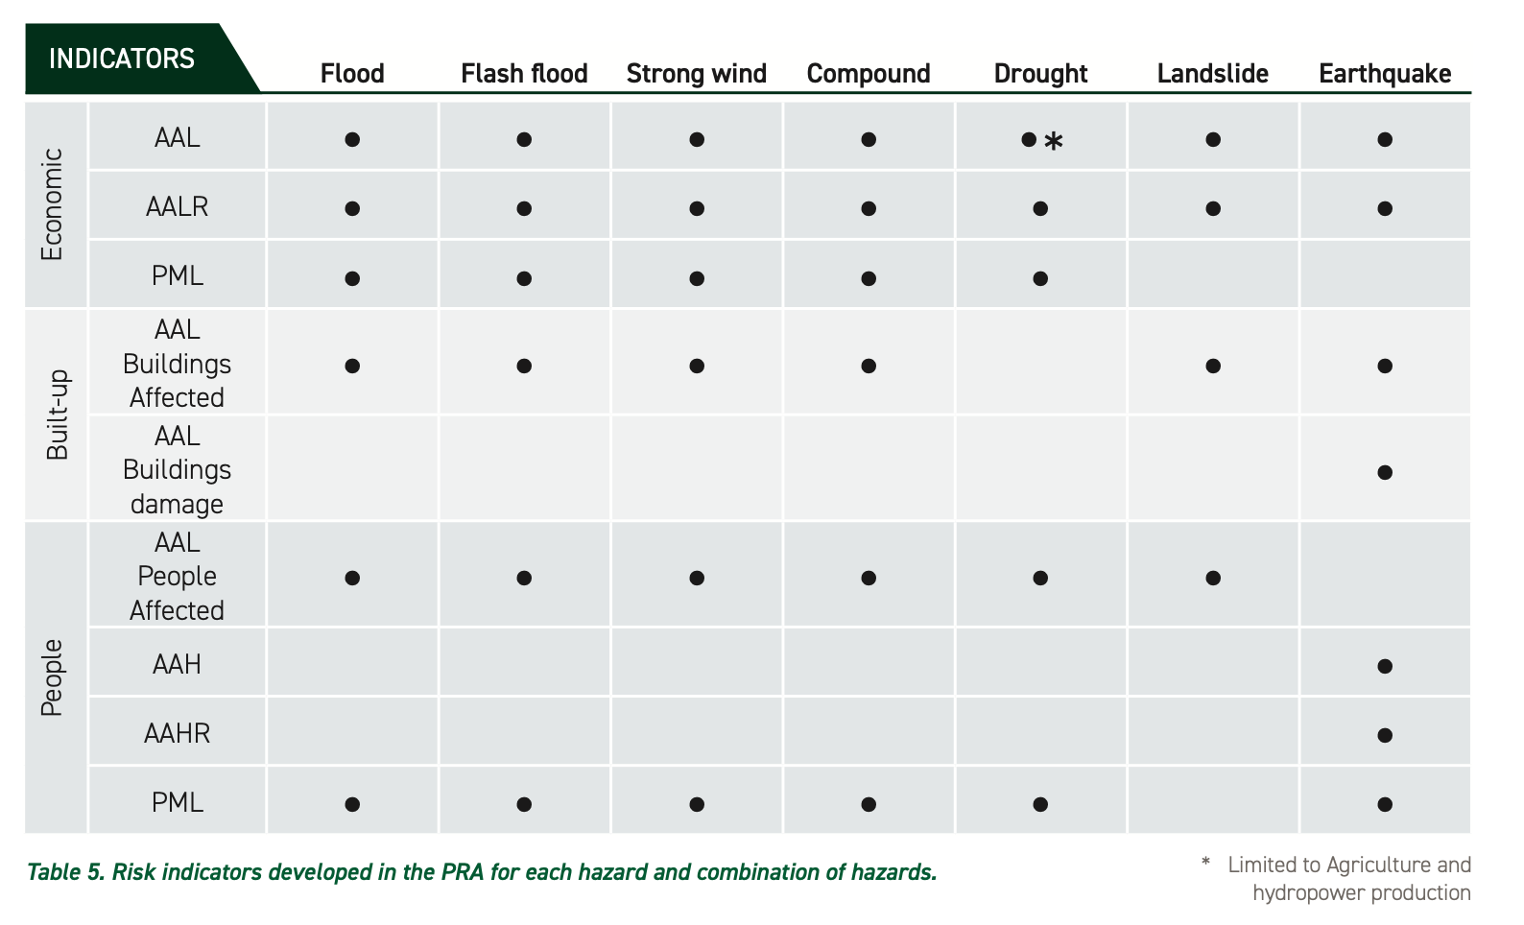
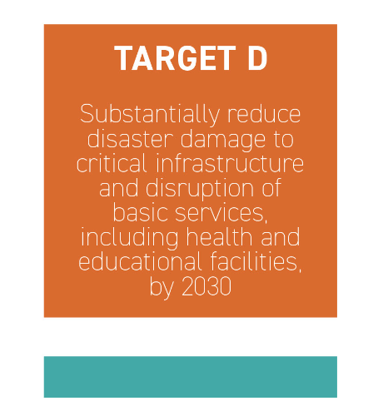
Risk Assesment indicators

Slide 33



Risk Assesment Multi-hazard
Drought is the Hazard affecting most people
Riverine Floods and Strong Winds the ones causing the higest direct economic losses

Slide 34


Riverine Flood Risk Assesment - population
People are affected when:
They loose their property
They loose their houses
They Loose access to critical services (e.g. Health, Education)
Flood Risk in Malawi is high in many district from North to South
When climate change is considered the southern district of Malawi are the ones with the higest increase in risk
The PML Curve saturates around 50-year RP, affecetd population by extreme events will increase up to 7 times in projected climate

Slide 35


Riverine Flood Risk Assesment - Economy
Economic loss:
It is computed by sector
It is computed for present climate and the 2 future climate projections
It is presented both in absolute terms and in relative terms
The housing sector dominates the losses
If climate change is factored in losses are similar for the optimistic scenarios while increases of 25% for the pessimistic.
Damage to agriculture doubles with climate change irrespective of the scenario considered

Slide 36



Riverine Flood Risk Assesment - Economy
Economic losses in Malawi are concentrated in the areas with the highest physical vulnerability
When climate change is considered losses increase consistently throughout the country
The PML Curve saturates around 50-year RP, economic losses by extreme events will double in projected climate posing serous challenges in terms of resilience

Slide 37

Riverine Flood Risk Assesment – Critical Infrastructures
Critical infrastructures include:
Health facilities
Education Facilities
Governamental buildings
Roads
Railwais

Slide 38

Riverine Flood Risk Assesment – Social Vulnerability
Affected Population
Vs
Food Security
Economic Damage
Vs
Poverty Indicator
Building Affected
Vs
Inactive Population

Slide 39


Flash Flood Risk Assesment – Highlights
People affected by Flash Floods in Malawi are evenly distributed among North, Central and Southern districts
Climate change will exacerbate the losses mainly in the southern part of Malawi
When socio-economic vulnerability is factored in hotspots emerge more clearly.

Slide 40


Strong Wind Risk Assesment – Highlights
Economic Losses by strong wind in Malawi concentrate mainly in the Central region.
Climate change will increase losses only in few districts while the general tendency is towards a reduction of the impacts.
When socio-economic vulnerability is factored in hotspots emerge more clearly.

Slide 41


Compound Risk Assesment – higlights
The housing sector dominates the losses
If climate change is factored in losses for the optimistic scenario reduce (because of the reduction in wind related losses) while increases of 20% for the pessimistic.
Damage to agriculture doubles with climate change irrespective of the scenario considered, direct damage to infrastructure also increases.
The combined effect of fast onset extreme events doubles the impact when climate change is considered.

Slide 42


Drought Risk Assesment – higlights
Droughts affect people mainly in the central and southern part of Malawi
Climate change will increase the number of affected people consistentrly throuout the whole country
Affected people could reach 1M already for a 25-year event by the end of the century

Slide 43



Drought Risk Assesment – higlights
Economic losses to agriculture and food energy supply losses have similar spatial patterns also in terms of climate change anomalies
Some crops dominate the cotribution to the total losses estimated.

Slide 44


Landslides Risk Assesment – higlights
The impact of landslides varies significantly across districts, with rural areas typically facing higher risks due to less robust infrastructure
The southern region is the most affected by smaller landslides while the pattern of larger landslides is more homogeneous.

Slide 45


Earthquakes Risk Assesment – higlights
Affected Population
Vs
Food Security
Economic Damage
Vs
Poverty Indicator
Building Affected
Vs
Inactive Population

Slide 46
Earthquakes Risk Assesment – higlights
Seismic risk in absolute terms concentrates along the Lake Shore where the seismicity is higher and where the stock value increases

Slide 47

District Level Atlas - Example
Comprehensive Multi hazard Risk Assessment in Malawi
All AALs and PMLs are provided at district level disaggregated by Hazard, Sector and climate

Slide 48


District Level Atlas - Example
Comprehensive Multi hazard Risk Assessment in Malawi
Detaled maps overlaying the hazard intensities and the potentially impacted assets are produced for each district.

Slide 49

Malawi Risk Platform
Comprehensive Multi hazard Risk Assessment in Malawi
Landing Page
Information Slider
Summarizing Figures
Disclaimer

Slide 50

Malawi Risk Platform
Comprehensive Multi hazard Risk Assessment in Malawi
News
Logos
Site structure and disclamers

Slide 51

Malawi Risk Platform
Comprehensive Multi hazard Risk Assessment in Malawi
Map Viewer section
Map Viewer
Feature Tab
Zoom
BG Layer
INFO Tool
Measure
Theme Filter
Pre-cooked Layers’ selection – based on filter values
Control Map

Slide 52
Malawi Risk Platform
Comprehensive Multi hazard Risk Assessment in Malawi
Map Viewer
Feature Tab
Map Viewer section
Layer controls:
Pinning
Metadata
Publication
Transparency
Legend

Slide 53

Malawi Risk Platform
Comprehensive Multi hazard Risk Assessment in Malawi
Map Viewer
Explore Tab
Map Viewer section
Advanced Filter and Search
Full List of avallabile layers

Slide 54

Malawi Risk Platform
Comprehensive Multi hazard Risk Assessment in Malawi
Map Viewer
Explore Tab
Map Viewer section
Advanced Filter
Hierarchical Filter:
Categories
Tags

Slide 55

Malawi Risk Platform
Comprehensive Multi hazard Risk Assessment in Malawi
Pinned Layers Tab
Map Viewer section
Pinned Layers List

Slide 56

Malawi Risk Platform
Comprehensive Multi hazard Risk Assessment in Malawi
Dashboard section
Categories Filter
Tags Filter
Geographic Filter:
Admin 0
Admin 1
Resources Space:
Maps, Graphs, animated graphs, Texts

Slide 57

Malawi Risk Platform
Comprehensive Multi hazard Risk Assessment in Malawi
Dashboard section
Resources Space:
Maps, Graphs, animated graphs, Texts

Slide 58

Malawi Risk Platform
Comprehensive Multi hazard Risk Assessment in Malawi
Documentation section

Slide 59

Malawi Risk Platform
Comprehensive Multi hazard Risk Assessment in Malawi
Contacts section

Slide 60
Malawi Risk Platform
Comprehensive Multi hazard Risk Assessment in Malawi
Now lets Go Live !

