Slide 1
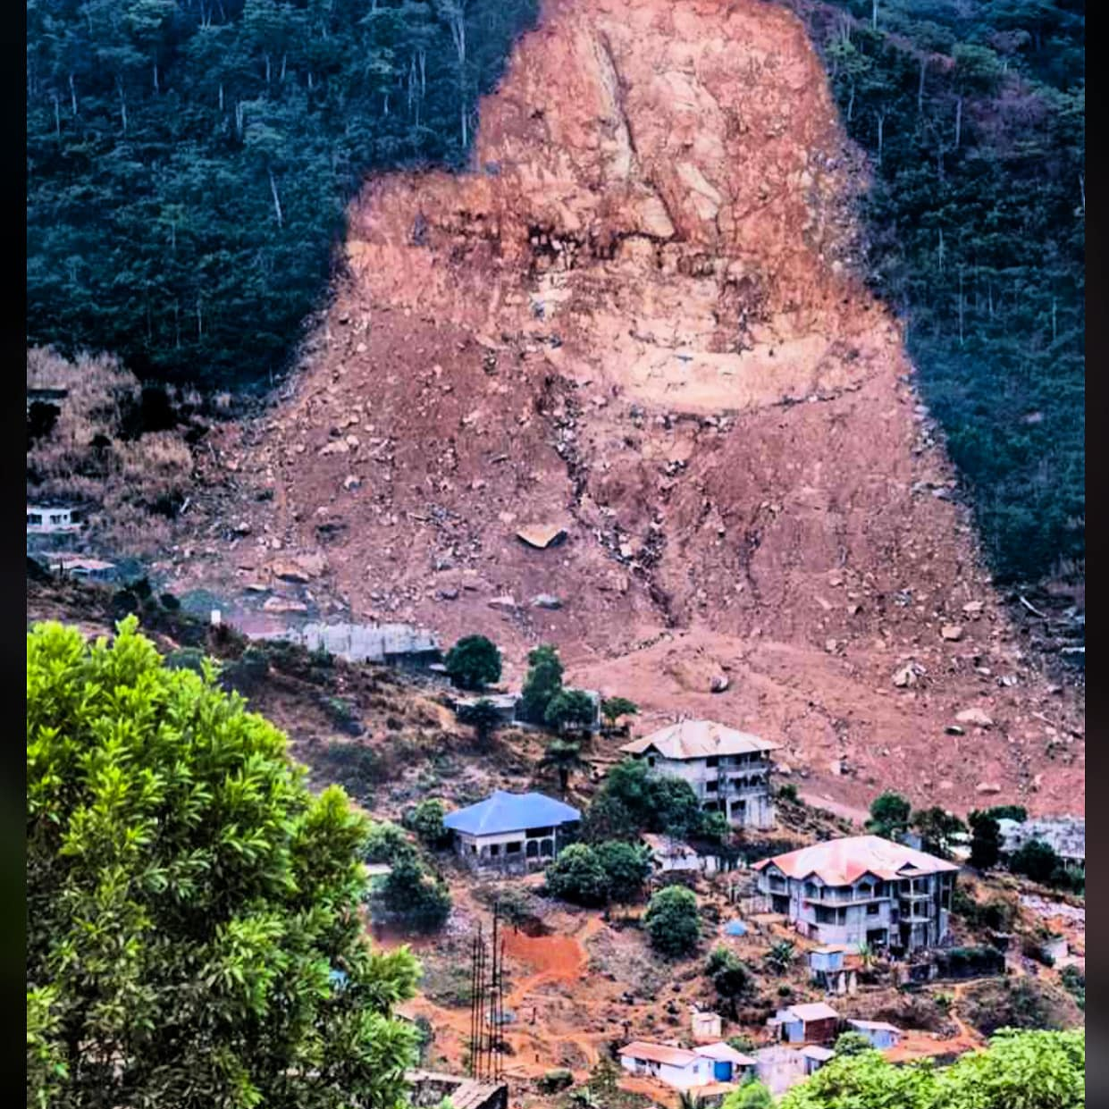
Resilient Malawi: Charting a Path for enhanced Disaster Risk Management
Reflections from Sierra Leone
December 11, 2024

Slide 2
Introduction
On a general note, there are huge similarities between Sierra Leone and Malawi with regards to climate and weather-related hazards and disasters.
Whilst we notice that droughts, cyclones, landslides, and earthquakes are the main occurrences for Malawi, Sierra Leone has flash floods, landslides and windstorms as the prevalent disaster impacting occurrences.
The 2017 Freetown mudslide and resultant flooding is the country’s biggest natural disaster, resulting to the death of over 3,000 in less than three hours.
Thousands were displaced and hundreds of residents destroyed. A damage and loss assessment carried by the world Bank showed that the 2017 mudslide cost the economy over 30 million dollars.

Slide 3
Introduction
As a result of the annual six months of rains (May – October), riverine flooding heavily impacts on agriculture farmlands and islands
Sierra Leone is a seismically stable area and there have been no records of major earthquakes. However, the country experiences annual coastal erosion and sea level rises that impacts communities living along the coastal areas.
The country also experiences human induced disasters such as urban fires, because of poor settlements and building collapse due to lack of development controls and substandard construction
The incidences of weather-related hazards and disaster have been happening in Sierra Leone even before independence in 1961, but the impact was limited and controllable. With the civil war (1991 – 2002) and massive migration to urban areas, human activities have led to profound deforestation, especially around the capital (Freetown) peninsular, leading to increased occurrences of weather and climate related hazards with their accompanying devastating effects.

Slide 4
Institutional frameworks and Regulations
No | Malawi | Sierra Leone
1 | DRM Act | NDMA Act of 2020 in which the Vice President is Chairman of the National Platform for Disaster Risk Reduction
2 | DRM Policy | National Disaster Risk Management Policy
3 | National Contingency Plan | National Disaster Management Preparedness, Response and Recovery Plan
4 | Robust Meteorological Agency | SOP of Relief
5 | Geological Survey | Disaster Risk Financing Strategy
6 |  | Sierra Leone Incidents Management System
7 |  | Sierra Leone Meteorological Agency
8 |  | National Water Resources Management Agency

Slide 5
World Bank Intervention through the Resilient Urban Sierra Leone Project (RUSLP)
We have learned from the presentations made during this symposium that Malawi has conducted a lot of studies on DRM with a clear influence on DRM related policies. We observed that the Malawi approach on building resilience has a strong nexus between urban planning and disaster risk management. This is ONE KEY takeaway for the Sierra Leone delegation.
We observed that Malawi is advanced in the use of technology in DRM and resilience building. The use of software and drones to simulate scenarios and do anticipatory actions is commendable and worthy to note.
Although we recognise the fact that Sierra Leone has a lot of catching up to do in terms of addressing DRM issues, the World Bank-supported Resilience Urban Sierra Leone Project, is one of the main efforts at addressing disaster related issues in the country. Project interventions include:

Slide 6
World Bank Intervention through the Resilient Urban Sierra Leone Project (RUSLP)
1.Institutional and capacity building interventions for the National Disaster Management Agency (NDMA, the Sierra Leone Meteorological Agency (SLMet) and the National Water Resources Management Agency (NWRMA) to spearhead disaster preparedness, response and early warning. The project will also construct a National Emergency Operations Centre (NEOC) under the NDMA
2. Development of a Strategic Flood Risk Assessment and Management Plan for the Secondary Cities in Sierra Leone (Bo, Makeni, Bonthe, Kenema, Koidu New Sembehun, Port Loko, and Waterloo)
3. Development of Western Area Regional Spatial Plan, including the Freetown Structure Plan
4. Development of spatial plans for the six secondary cities (Bo, Makeni, Bonthe, Kenema, Koidu New Sembehun and Port Loko)
5. Review of the Town and Country Planning Act as well as developing Building Codes for urban development
6.Development of a National SWM Strategy. Uncontrolled management of solid waste is considered a major contributing factor to community level flooding in the rainy season

Slide 7
Disaster Risk Financing
The NDM Act (2020) made provision for the establishment a disaster management fund. Residual resources from the mud-slide were used as seed money for the fund. Government as you can imagine has been challenged to replenish the funds. However, government and development partners have been responding to disaster as and when they occur amidst these challenges.
Government, led by the Ministry of Finance with support from the World Bank has developed a Disaster Risk Financing Strategy with a clear implementation plan. The importance of this cannot be overemphasise given the fact that disasters are becoming an annual event in Sierra Leone.
Also, part of why we are here is to learn from colleagues in the Ministry of Finance in Malawi to know how Malawi is addressing disaster preparedness, with special reference to the World Bank Crisis Preparedness Financing instruments of the RRO, Cat DDO and CERP.

Slide 8
Disaster Risk Financing
We note the clear articulation of the DRM systems at the national and local government level in Malawi. We have not gone that far yet, but we have taking initial steps to ensure that local councils allocate 10% of own source revenue to DRM related activities, in addition to central government budgetary provision to the NDMA for DRM activities at the local government level.
The consistent occurrences of natural disasters on an annual basis, has triggered the ministry’s interest in activating the financing instruments with the World Bank. We are looking forward to having bilateral discussions with the Malawi Ministry of Finance and Disaster Management Agency as already indicated.

Slide 9
The End
Thank you for your attention

