Slide 1






GOVERNMENT OF MALAWI - THE WORLD BANK
DWR - NWRA - DCCMS - DODMA
SHIRE RIVER ODSS PROJECT
Project overall
9 December 2024

Slide 2
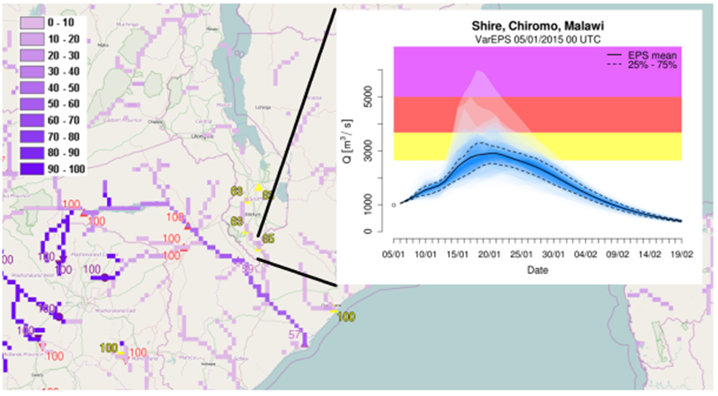
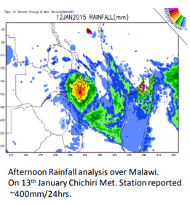
PROJECT BACKGROUND
In January 2015 in Malawi several weeks of heavy precipitation were followed by devastating flooding. It is estimated (Government of Malawi) that the floods affected 1.1 million, displaced 230,000 and killed 106 people. Recovery and rebuilding needs are estimated at around US$500 million.

Slide 3
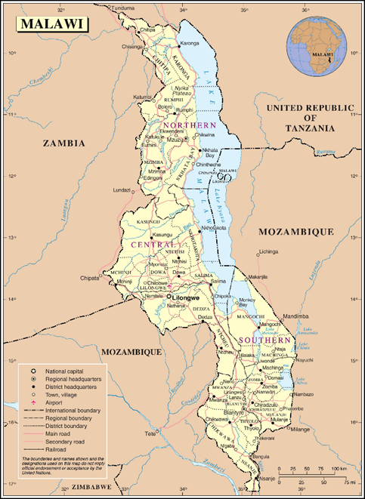
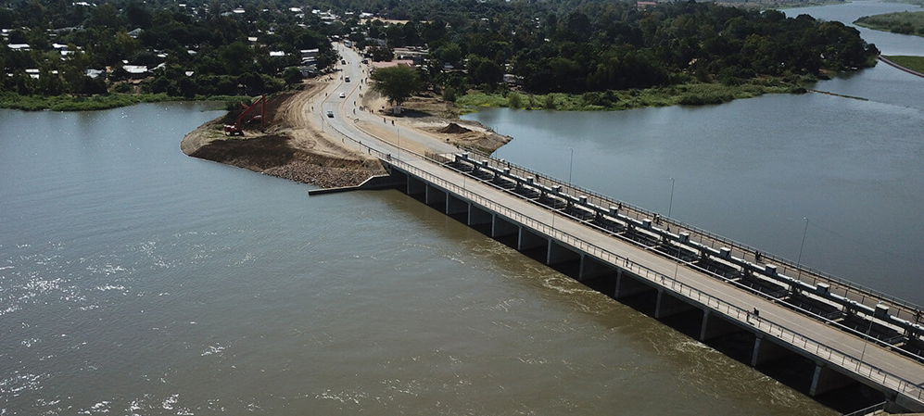
PROJECT BACKGROUND
The Shire River originates at the southern end of the Lake Malawi. It draws its main flows from the lake itself, and its hydrology is influenced by lake levels.
The main flow control and regulating facility on Shire River is the Kamuzu Barrage constructed in 1965 and situated at Liwonde.

Slide 4
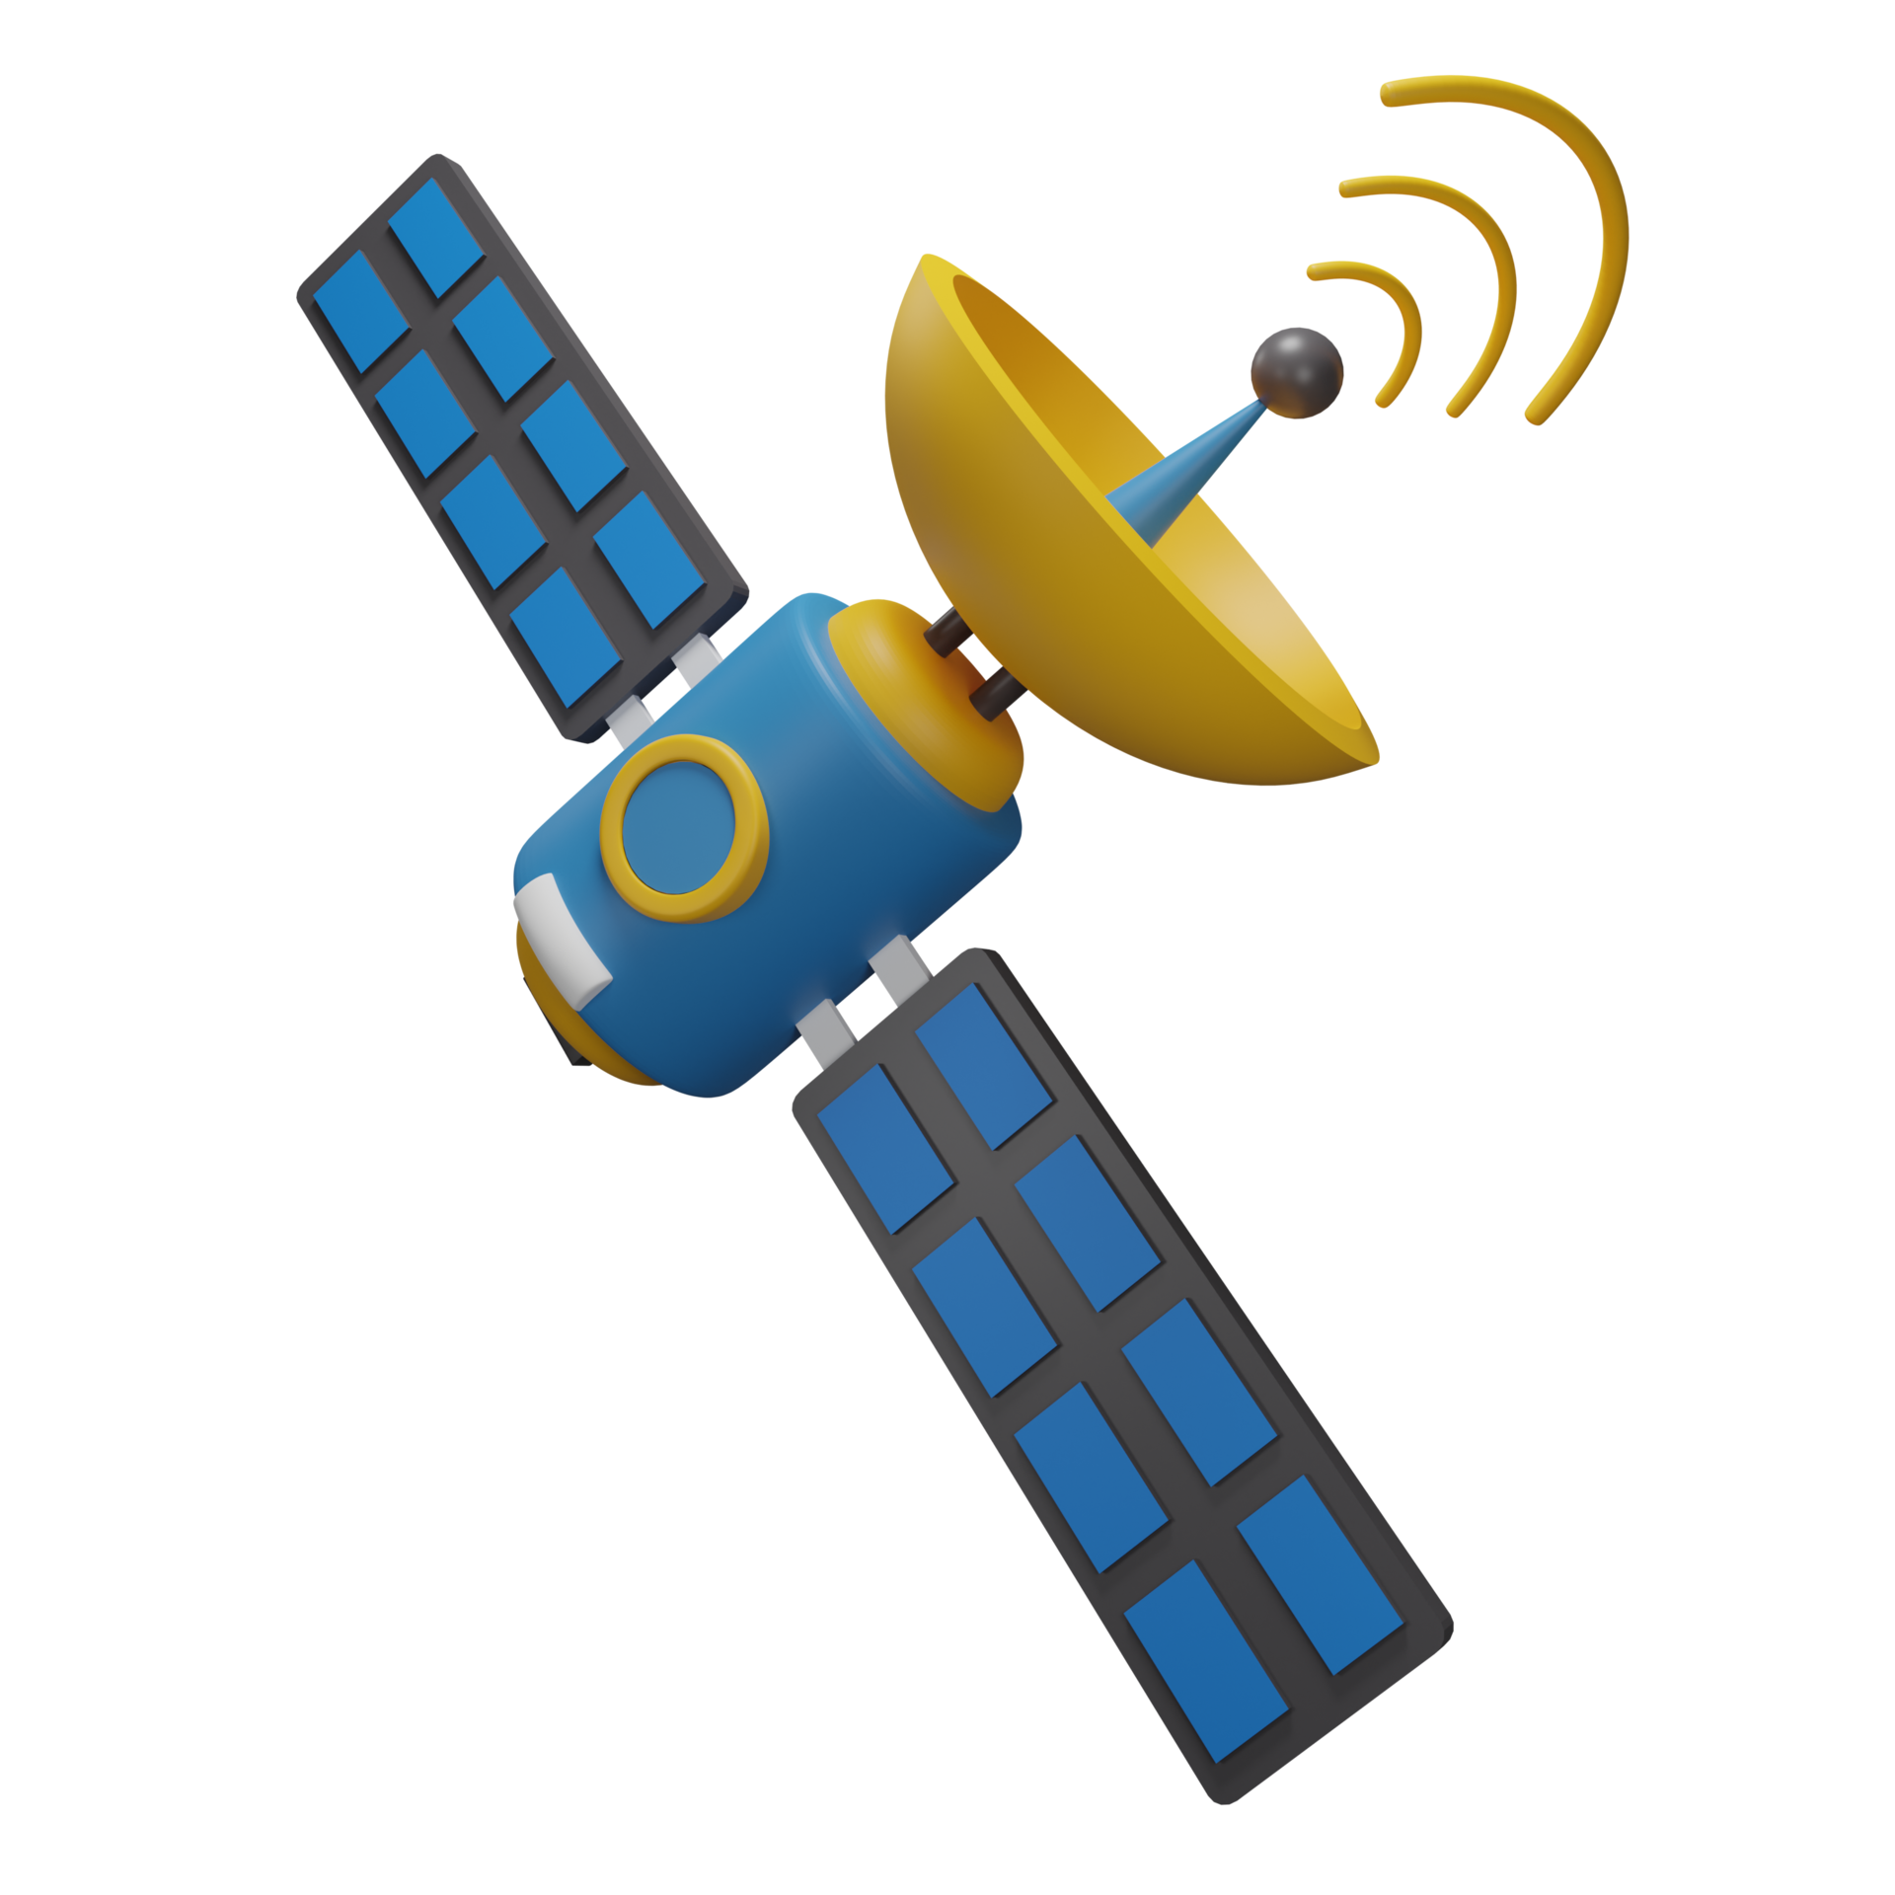
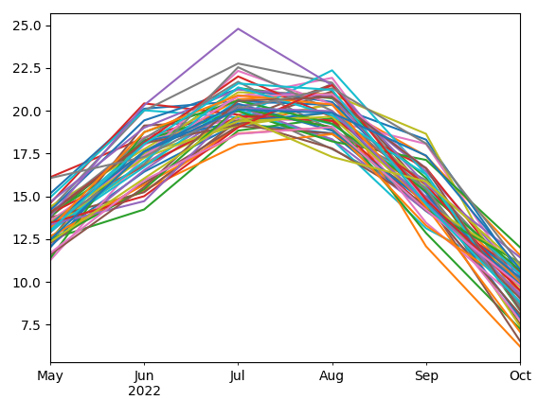










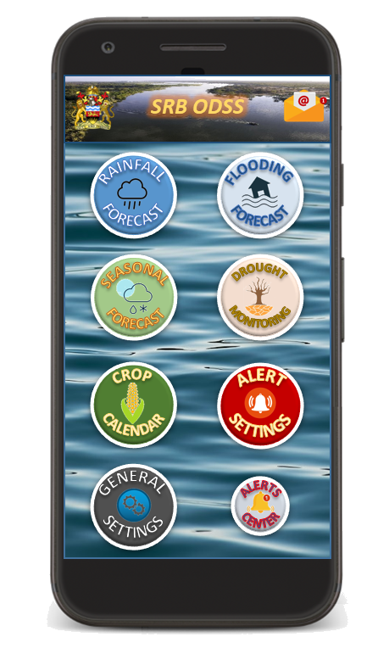

SCOPE OF WORK
From analyses to results and products
Satellite data and forecast data analysis
Hydrological model development
Hydraulic model development
Selection of Drought Indices
Analysis of crop calendar and LSP
Integrated analysis Lake – River
Stakeholders engagement
Training activities
Forecast dataseries
Calibrated Hydrological model
Flood extents forecast
Drought Monitoring and Crop Calendar
Infrastructures Connection: KABOM-ODSS
Web Platform and Geo-server Software
Standard Operation Procedures
Public Participation and Awareness

Slide 5
HYDRO METEOROLOGICAL DATA SOURCES
Name | Type | Source | Variable | Service
GFS | Short-term forecast + 72h | NCEP | Air temperature, precipitation | Rainfall forecast, Flooding forecast
COSMO-Malawi | Short-term forecast + 72h | DCCMS | Air temperature, precipitation | Rainfall forecast, Flooding forecast
SEAS5 | Seasonal forecast + 3M | CDS / ECMWF | Air temperature, precipitation, actual evapotranspiration | Seasonal forecast, Drought Monitoring, Crop Calendar
Seasonal Malawi | Seasonal forecast + 3M | DCCMS | Air temperature, precipitation, actual evapotranspiration | Seasonal forecast, Drought Monitoring, Crop Calendar
ERA5-Land | Re-analysis | CDS / ECMWF | Air temperature, precipitation, actual evapotranspiration | Seasonal forecast, Drought Monitoring, Flooding forecast,
Lake Malawi | Seasonal forecast + 3M | DCCMS | Level asl | KABOM linkage
Weather stations | In-situ observation | DCCMS | Precipitation | Rainfall forecast
Hydrometers | In-situ observation | DWR | River discharge | Flooding forecast, Seasonal forecast

Slide 6
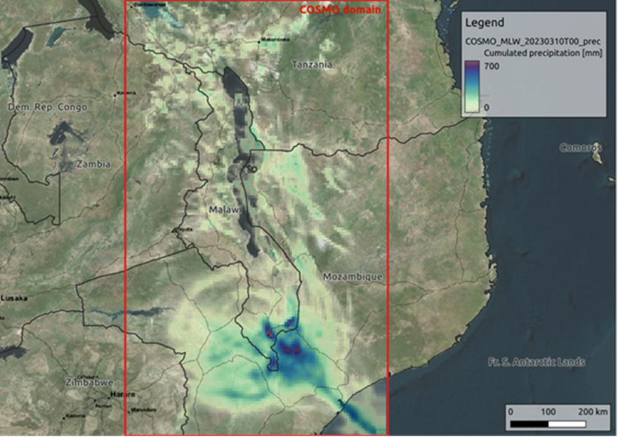
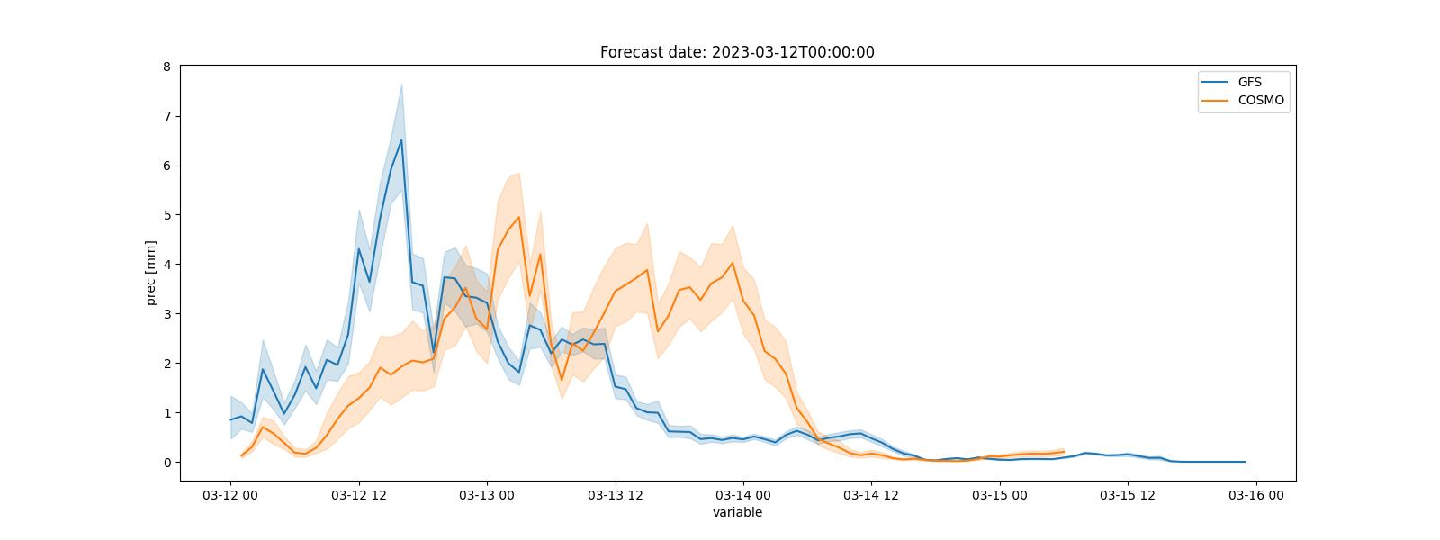
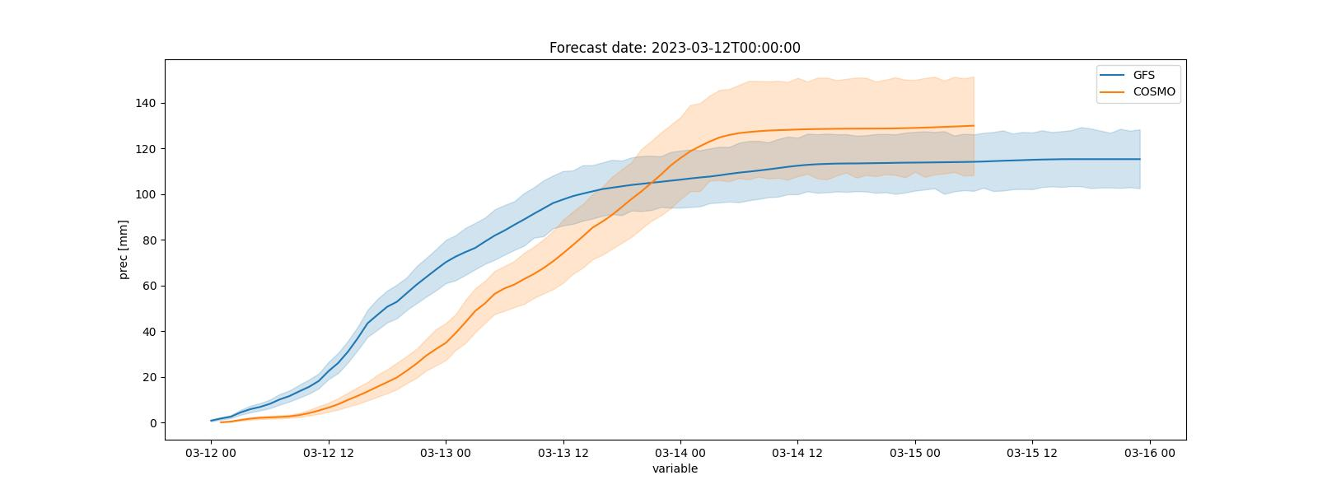
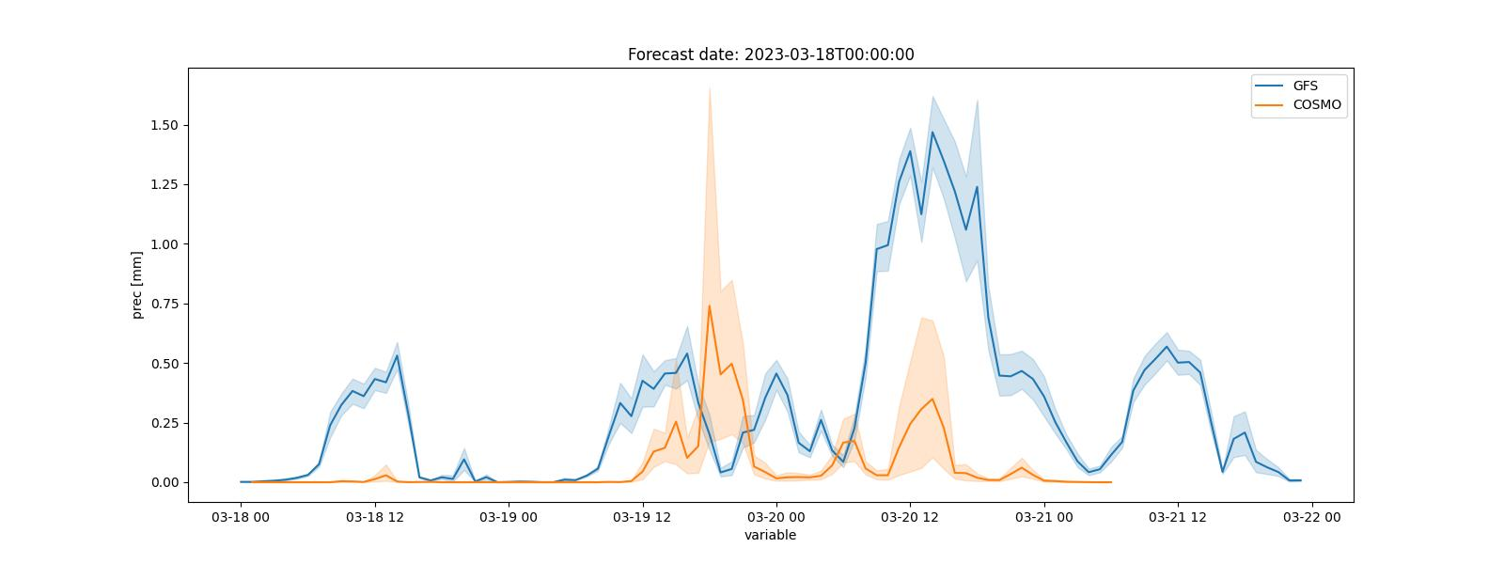
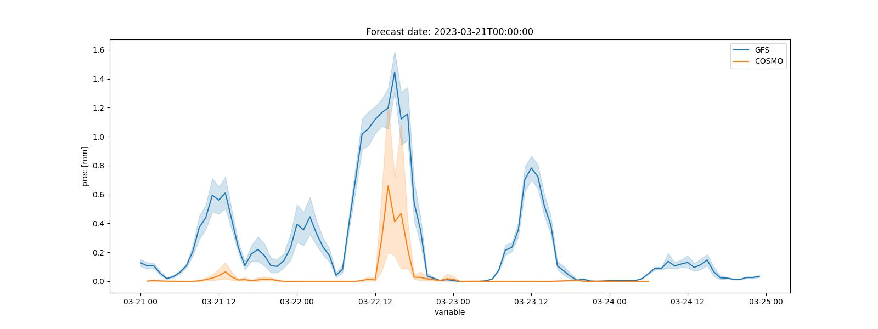
CLIMATE DATA FORECASTING
Short-term forecast models:
COSMO model (DCCMS) data exchange has been taking place on a daily basis since the end of March 2023.
To make the system more robust and to have an alternative source of forecasts, it was also decided to include the forecasts of the global weather model GFS, provided by the American NCEP

Slide 7
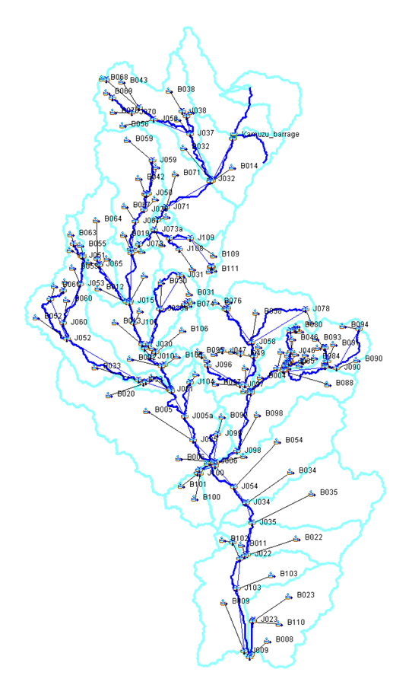
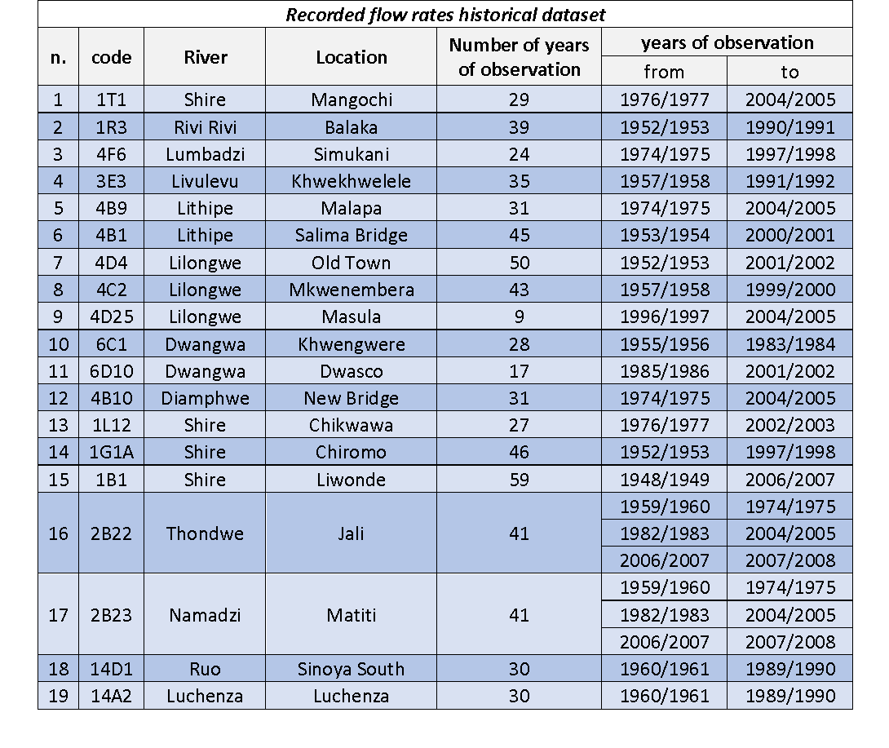
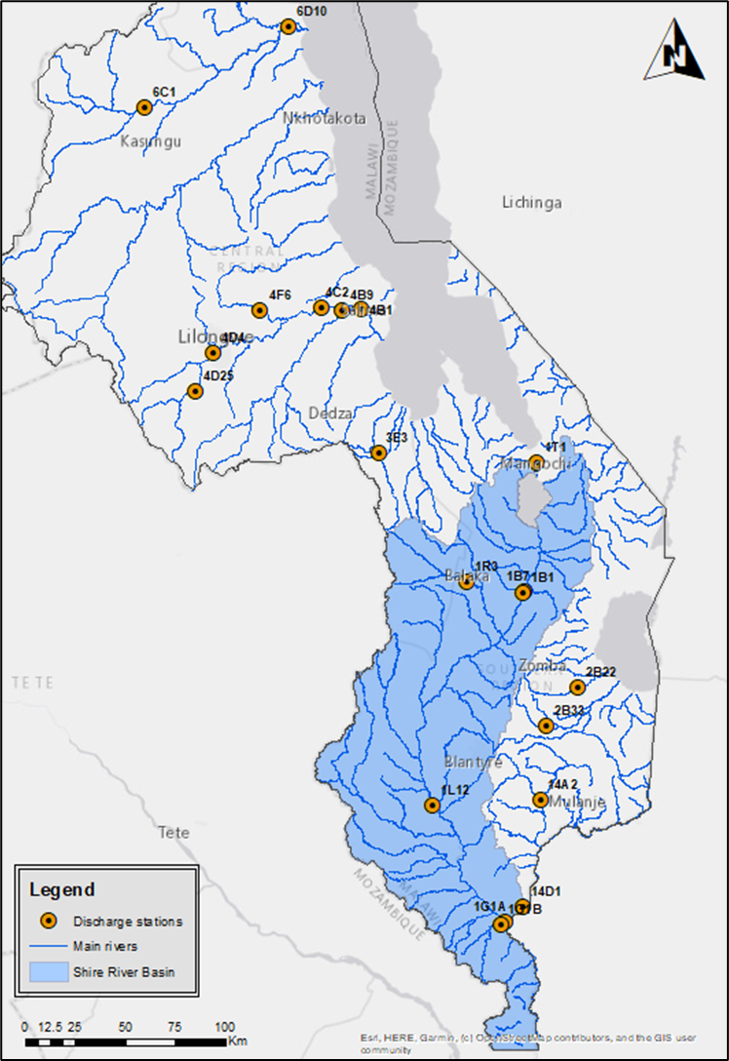
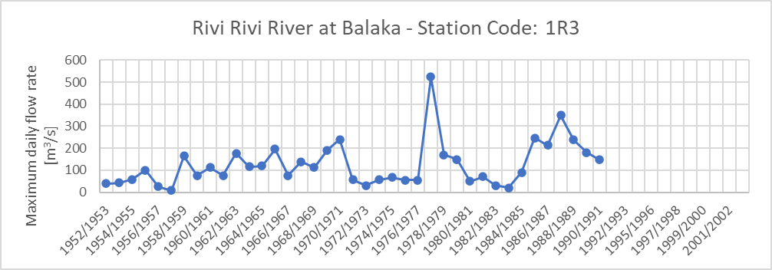
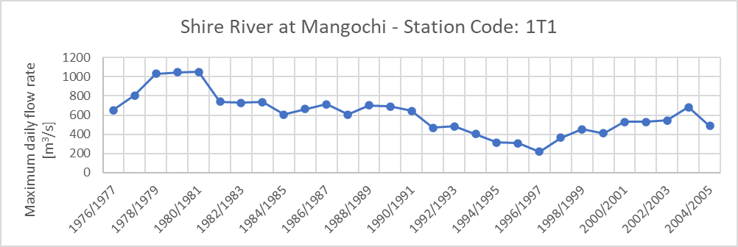
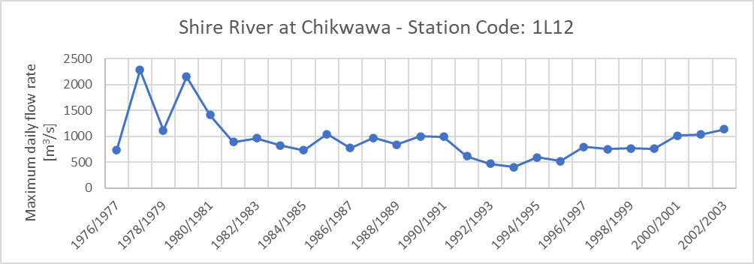
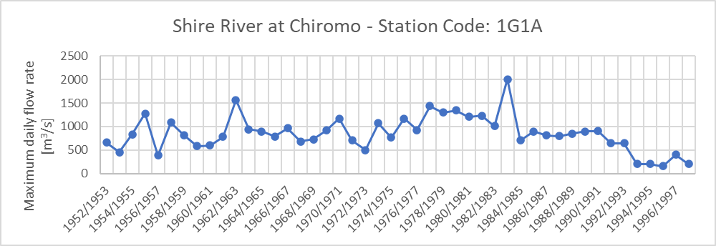
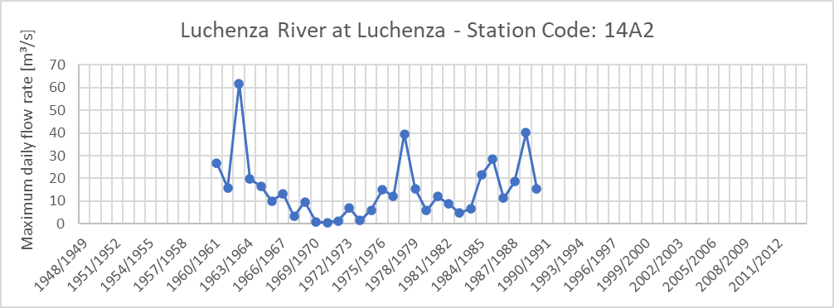
HYDROLOGICAL MODEL
Shire River Catchment Hydrological Model
The hydrological analysis is performed with the HEC-HMS software, that was calibrated with historical daily flow data recorded at Balaka, Chikwawa and Chiromo gauging stations.

Slide 8
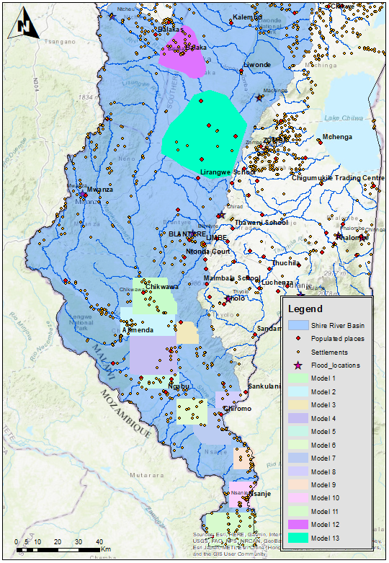
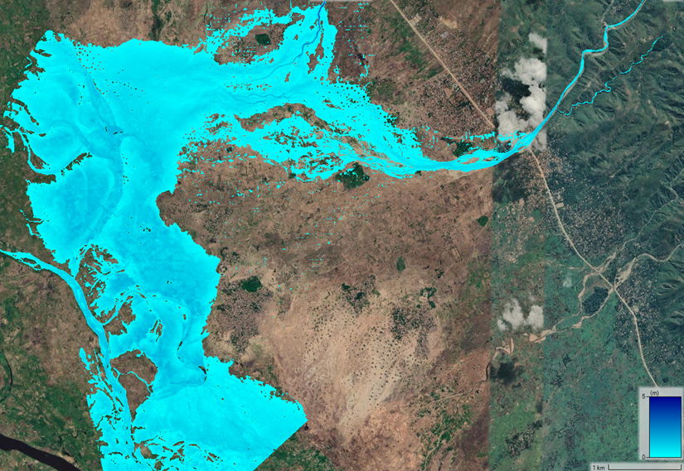
HYDRAULIC MODEL
The results of the hydrological model were used as input of the hydraulic model developed in HEC-RAS to define the 2D inundation maps of the 13 target areas, which were identified as the most prone to flooding phenomena.
MODELLED AREAS
Location of the flood investigation models
N. | Reference Location | Base Dem Source
1 | Chickwawa | Lidar
2 | Alimenda | Lidar
3 | East Nkate | Lidar +SRTM
4 | Jombo | Lidar
5 | Goma | Lidar
6 | Thudzu | Lidar
7 | Chiromo | Lidar +SRTM
8 | Makwalo | Lidar +SRTM
9 | Tengani | Lidar +SRTM
10 | Nsanje | Lidar +SRTM
11 | Kampata | Lidar +SRTM
12 | Balajka | SRTM
13 | Thundu | SRTM

Slide 9
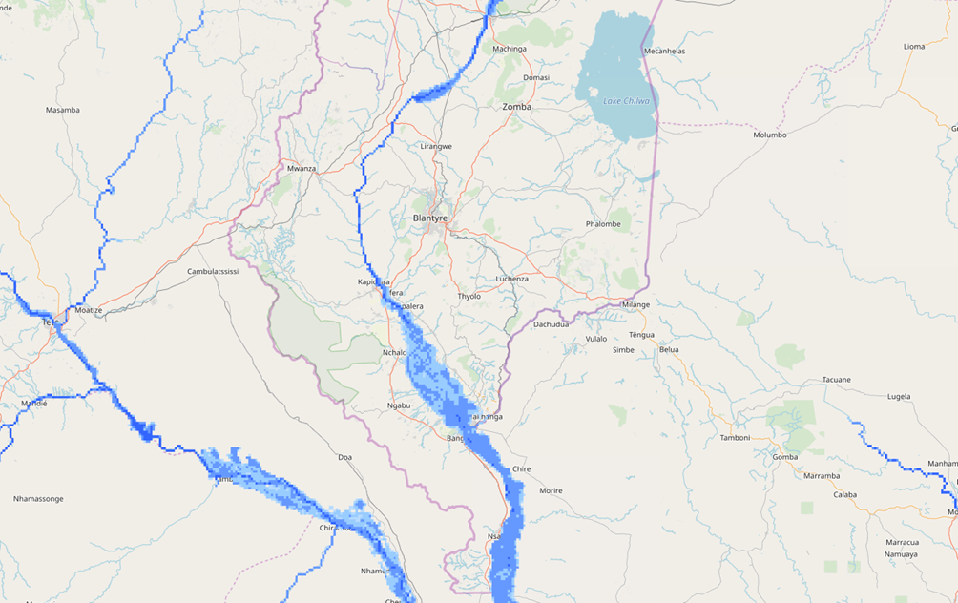


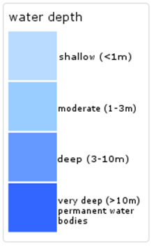
FLOOD CATALOGUE PRODUCTION
Flooding scenarios
A catalogue of flood scenarios was developed for each of the 13 areas of interest.
This approach was selected to overcome long computational time of the 2D hydraulic model.

Slide 10
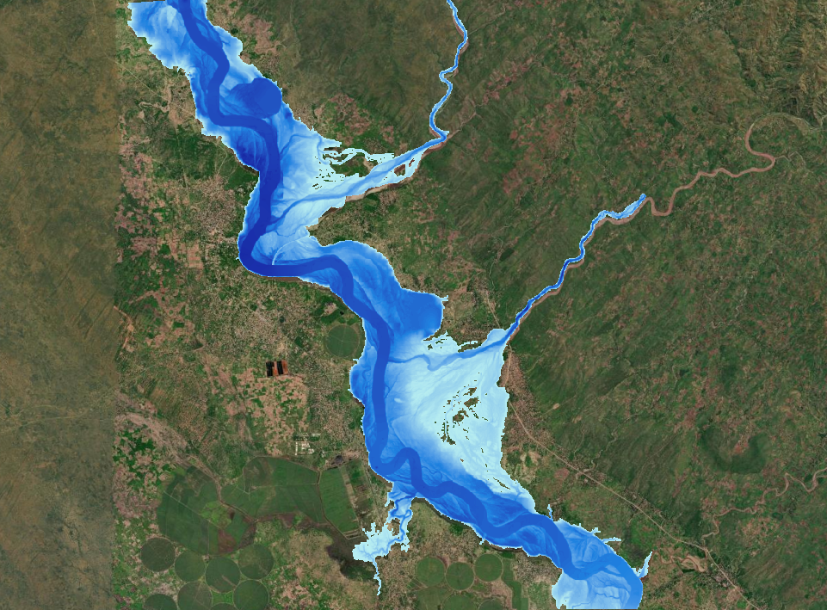
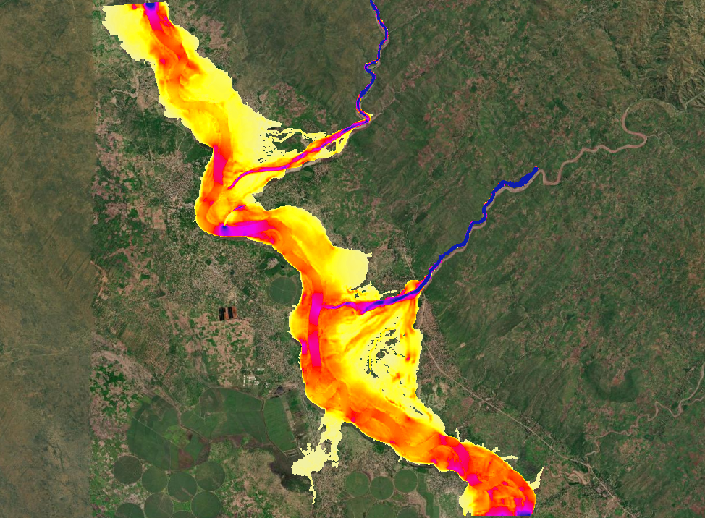
HAZARD MAPS PRODUCTION
Water Depth Map
Velocity Map

Slide 11
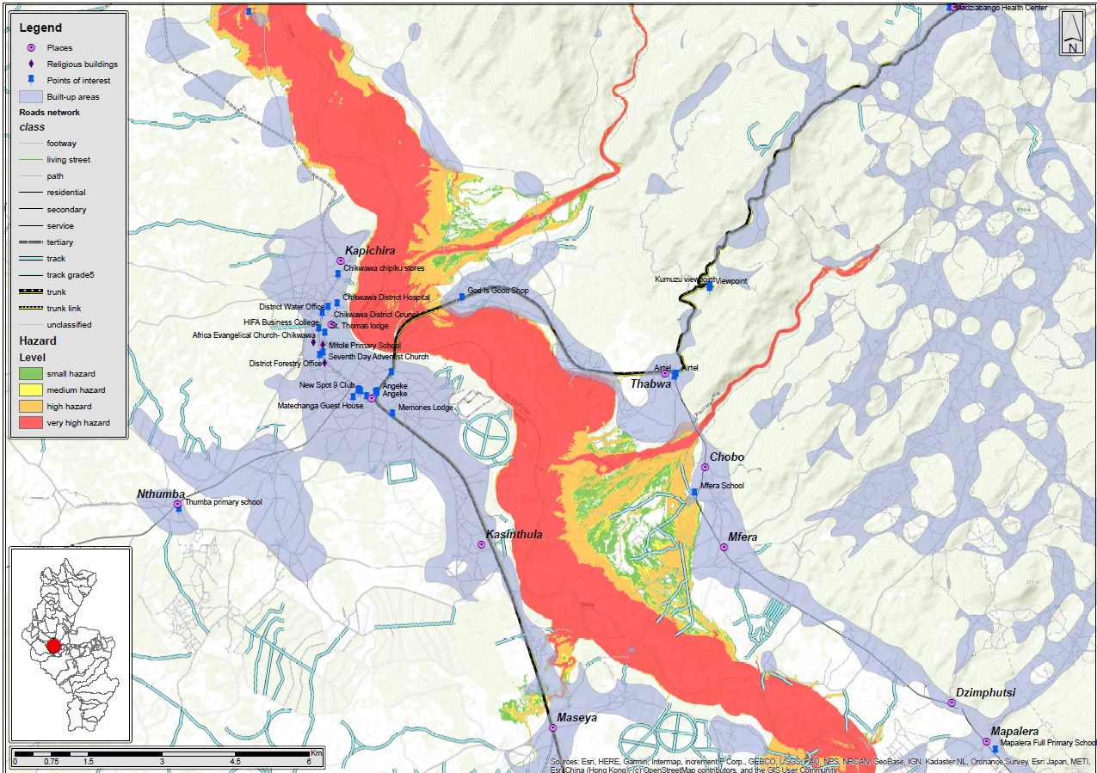
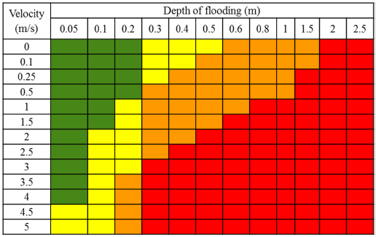
HAZARD MAPS PRODUCTION
Inundation maps were converted in flood hazard maps for each return period (25, 50, 100, 200 years), using the water depth - velocity matrix developed by Priest et al., in 2008 (international methodology).
FLOOD HAZARD MAP

Slide 12
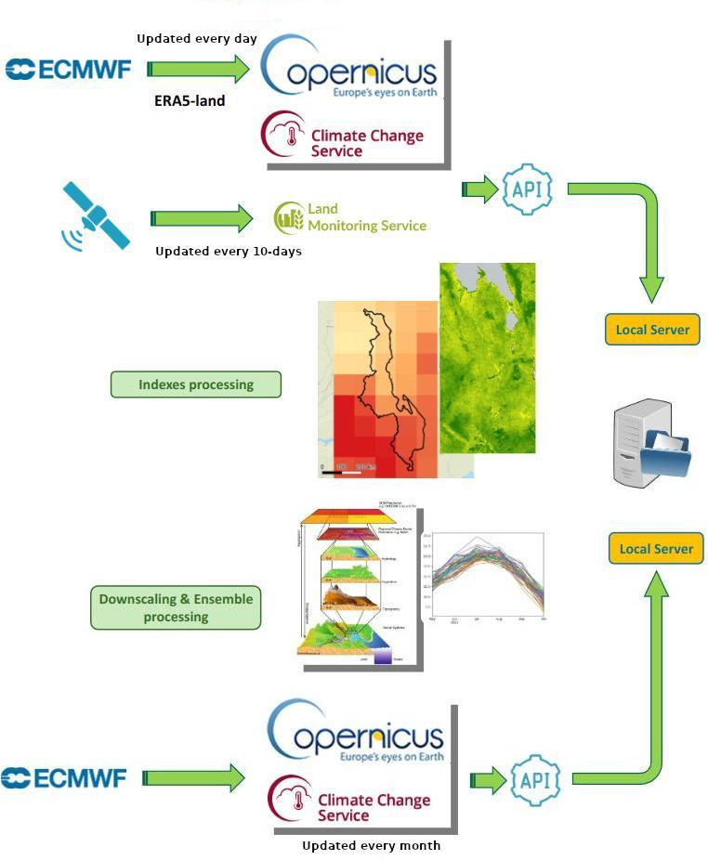
Drought monitoring
Drought monitoring indices:
  Water Balance Index (WBI): obtained from ERA5-land¹ reanalysis product with daily update
  Soil Water Index (SWI): obtained from the Copernicus Land² service with a resolution of 12.5 km and a daily update
  Normalised Difference Vegetation Index (NDVI): obtained from the Copernicus Land³ service with a resolution of 300 m and a 10 days update
Forecast drought index:
  forecast of the WBI (WBIf): obtained from the seasonal product by ECMWF and updated every month
Muñoz Sabater, J. (2019): ERA5-Land hourly data from 1950 to present. Copernicus Climate Change Service (C3S) Climate Data Store (CDS). DOI: 10.24381/cds.e2161bac
https://land.copernicus.eu/en/products/soil-moisture/daily-soil-water-index-global-v3-0-12-5km
https://land.copernicus.eu/en/products/vegetation/normalised-difference-vegetation-index-v2-0-300m
31th October 2024
9 December 2024

Slide 13
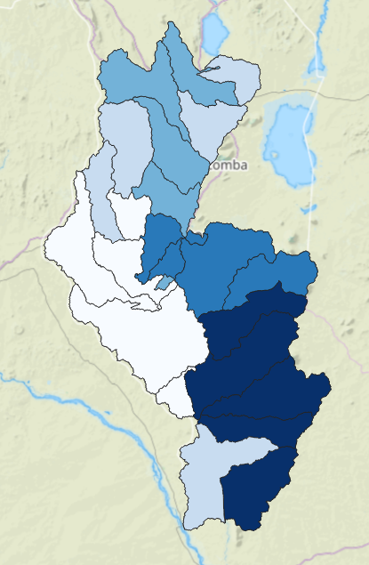
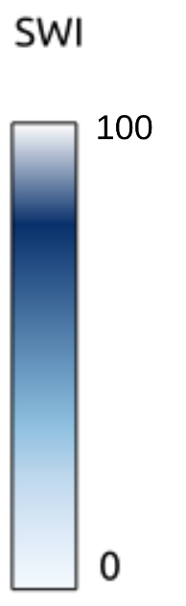
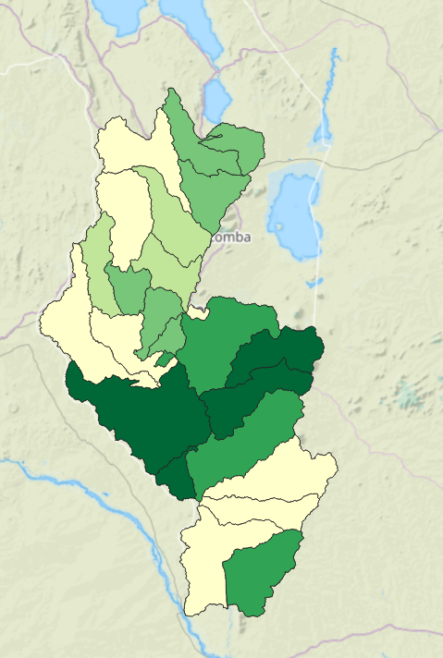
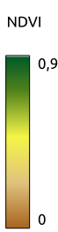

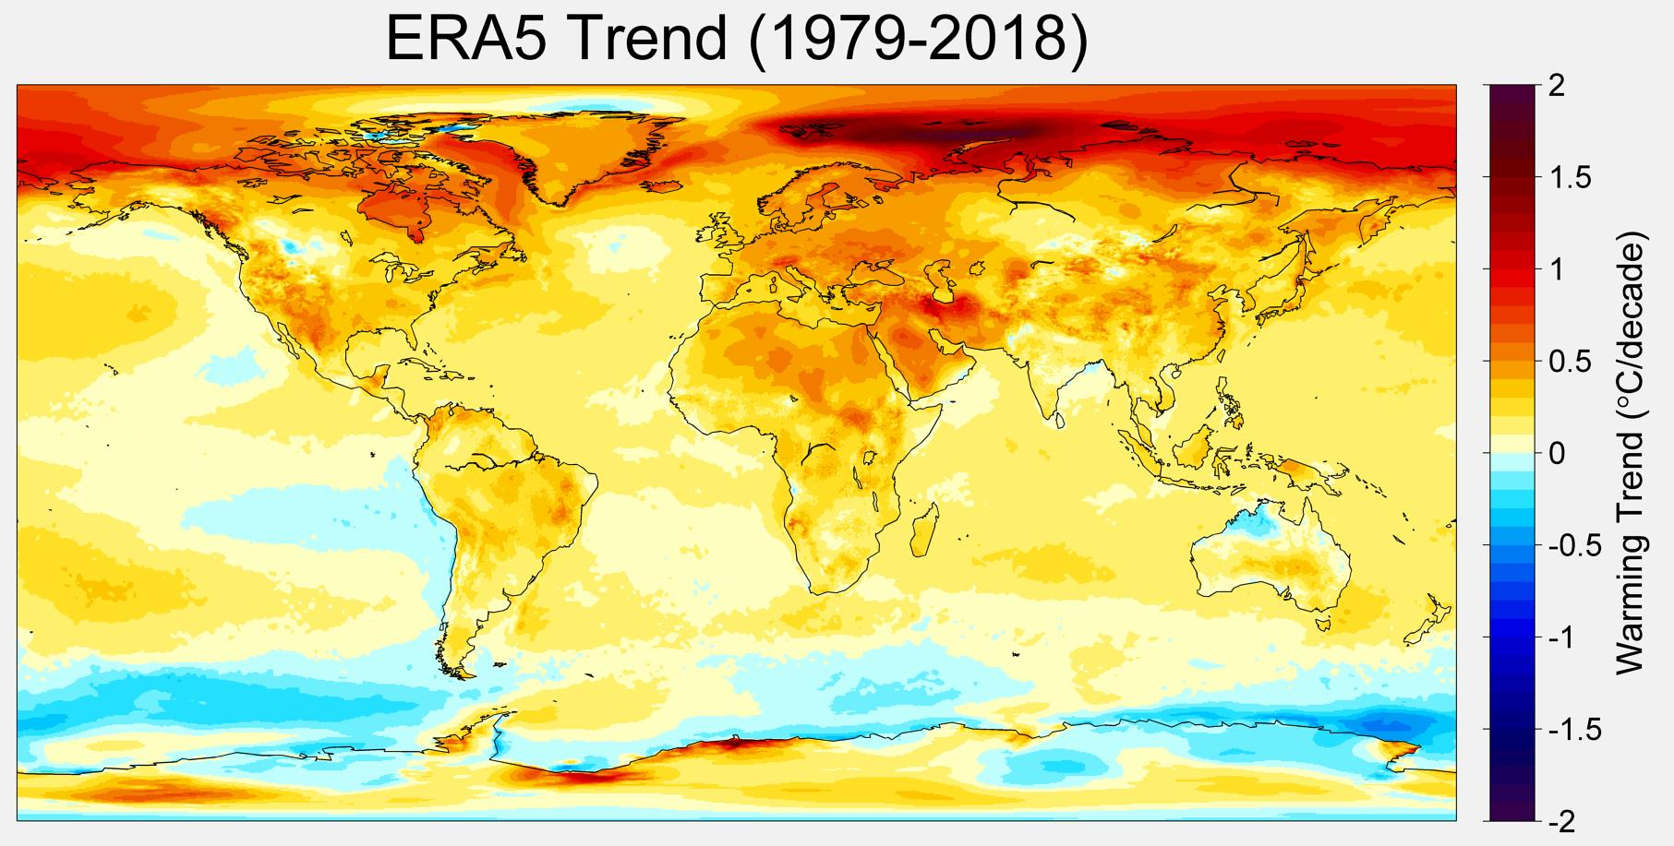

Drought monitoring
Water balance with ERA5-land dataset⁽¹⁾:
Water Balance Index = Precipitation - Evapotranspiration - Runoff
Spatial resolution: 0.1° x 0.1°
Update: daily
Delay: 5 days
Soil Water Index from Copernicus Land:
Spatial resolution: 12.5 km
Update: daily
NDVI index from Copernicus Land:
Spatial resolution: 300 m
Update: every 10 days
31th October 2024
9 December 2024

Slide 14
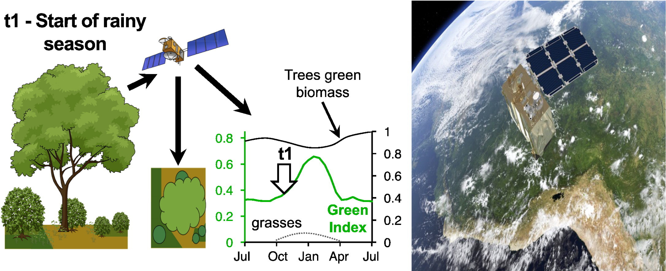
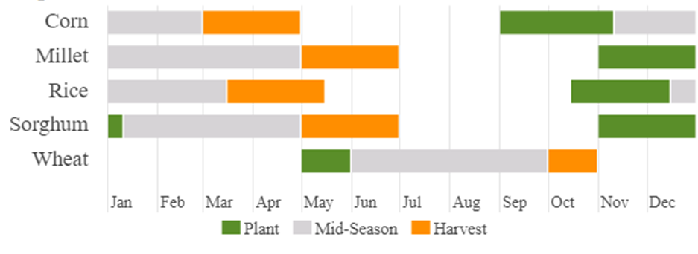
Crop calendar
The Land Surface Phenology (LSP) is an indicator that provides useful information for plant monitoring, such as:
time of onset of greening,
time of onset of senescence,
timing of the maximum development during the growing season, and growing season length.
LSP and seasonal forecast data can be used to confirm/adapt the crop calendar (sowing, harvesting), to identify any critical conditions during growth, and to predict eventual situations that could damage the crop.
https://land.copernicus.eu/en/news/global-land-surface-phenology-2023-available
31th October 2024
9 December 2024
Notes:
Helman D (2017): Land surface phenology: What do we really 'see' from space?, Science of The Total Environment, 618, DOI:10.1016/j.scitotenv.2017.07.23

Slide 15
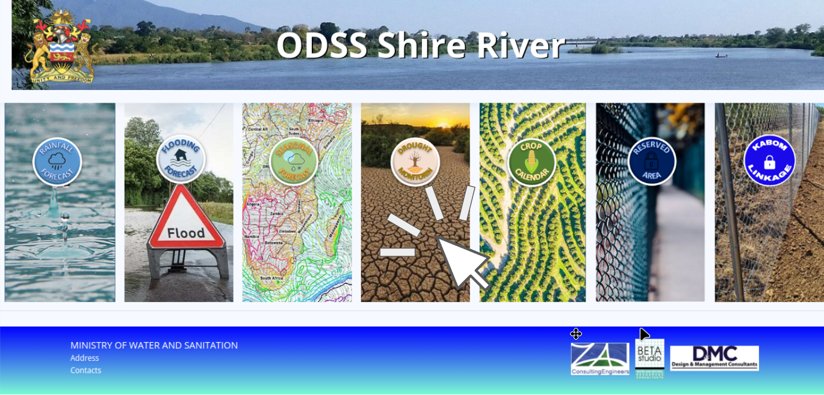
DISSEMINATION PLATFORM
7 sections with different functionalities
https://shire.odss.mw
9 December 2024

Slide 16

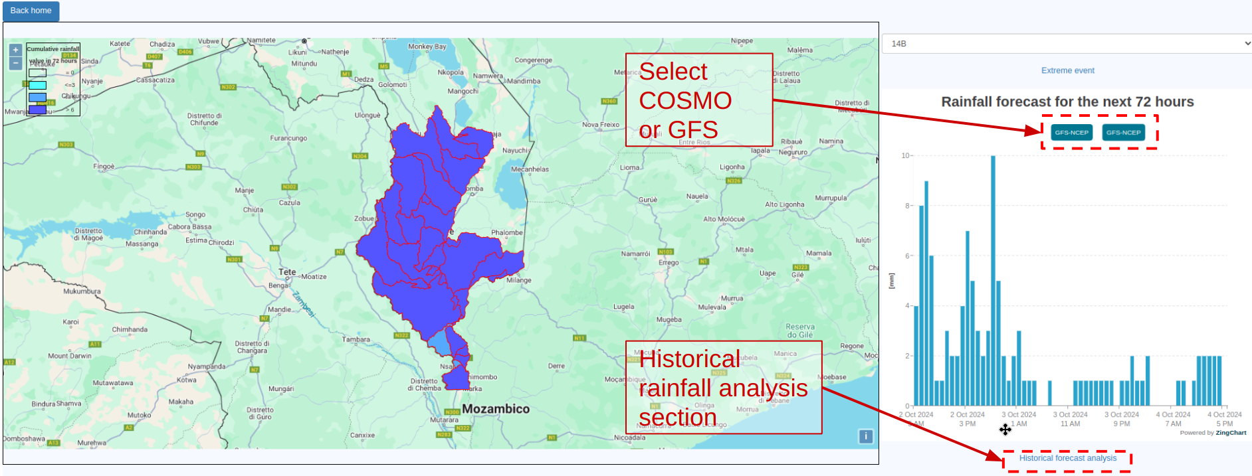
DISSEMINATION PLATFORM
Rainfall forecast section:
Forecast rainfall +72 hours
Include multiple model simulation (GFS and COSMO)
Historical results section
9 December 2024

Slide 17
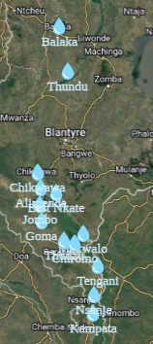
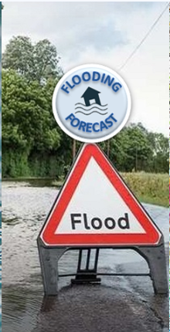
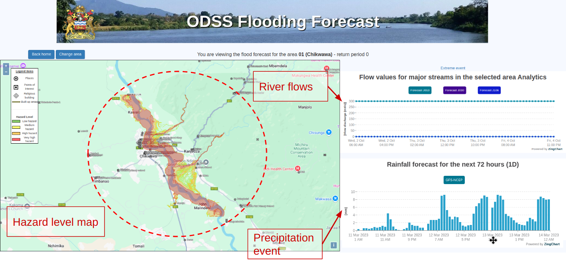
DISSEMINATION PLATFORM
Flood forecast section:
Flood hazard maps for 25, 50, 100 and 200 years RP at 13 locations
Flashing areas in case of risk to facilitate the user
Dynamic map activation based on precipitation forecast
9 December 2024

Slide 18
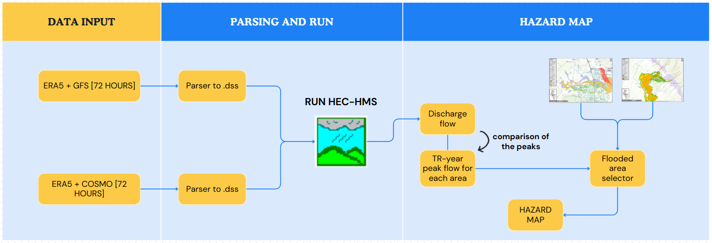
DISSEMINATION PLATFORM
FLOOD FORECASTING DAILY WORKFLOW

Slide 19
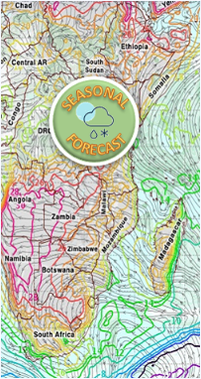
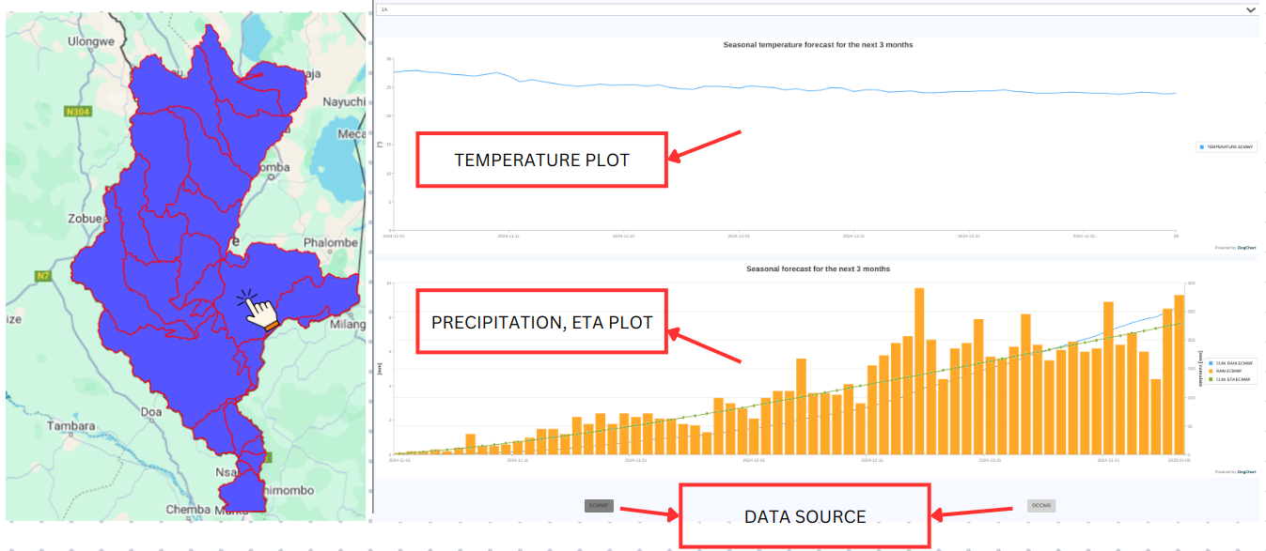
DISSEMINATION PLATFORM
Seasonal forecast section:
Precipitation, temperature and evapotranspiration +3 months
Monthly update
9 December 2024

Slide 20
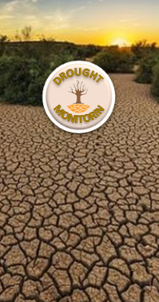
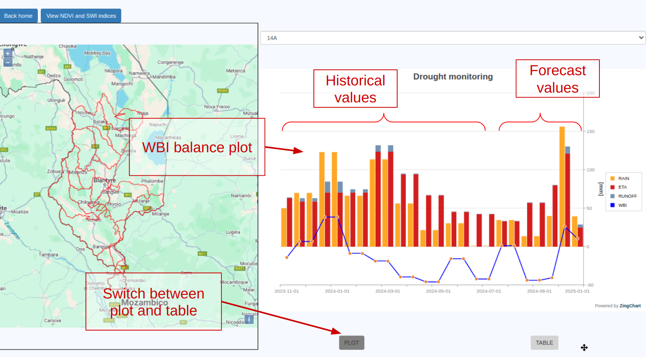
DISSEMINATION PLATFORM
Drought monitoring section:
Drought indices (daily updated): Water Balance Index (WBI), Soil Water Index (SWI), Normalised Difference Vegetation Index (NDVI)
Forecast index (monthly updated): forecast of the WBI (WBIf)
WBI plot
9 December 2024

Slide 21
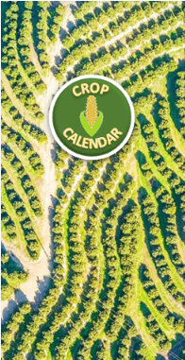
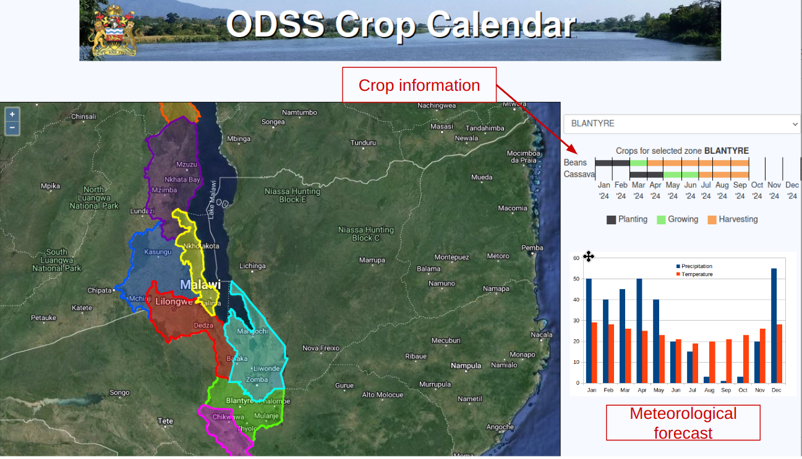

DISSEMINATION PLATFORM
Crop calendar section:
8 Agricultural Development Divisions (ADD) implemented
Comparison of sowing and harvesting periods with seasonal forecast weather data
Dynamic user interaction with the crop calendar and report generation (enabled users)
31th October 2024
9 December 2024

Slide 22
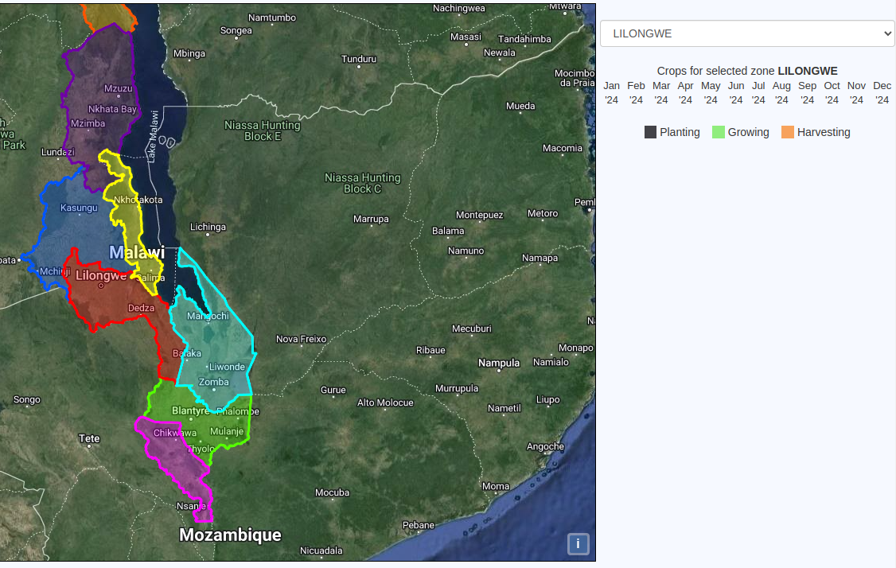

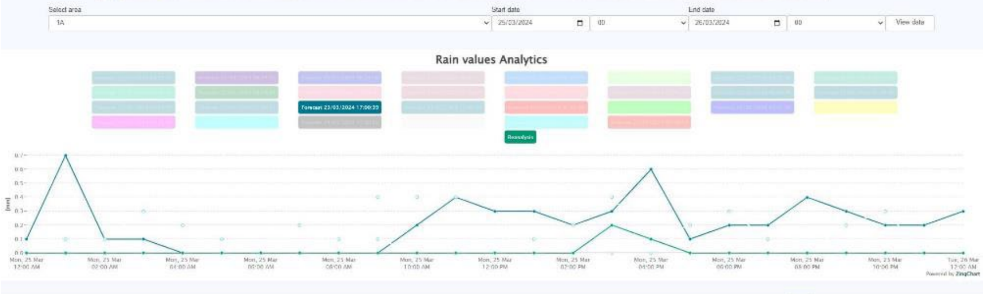
DISSEMINATION PLATFORM
CROP CALENDAR WORKFLOW
The platform uses the data from Drought Monitoring and the defined LSP to show the user all the information they need to determine when to sow or harvest.
Crop calendar
Drought monitoring and forecast data
Service platform
LSP
Meteo forecast
User interaction
31th October 2024
9 December 2024

Slide 23


KABOM linkage
A dedicated private area has been built for KABOM operators that allows:
access to short- and long-term forecast data
access to information on the status and forecast of the level of Lake Malawi
access to information on flow from the tributaries
communication with ODSS operators
With this tool, the KABOM operators can improve the information entered into the current Kamuzu Barrage Operating Model to optimise the water resource and minimize flood risks downstream.
31th October 2024
9 December 2024

Slide 24

Operational Protocols and Procedures - KABOM
KABOM current strategies
Routine water management in the river
Consider Lake Malawi level
Medium - term strategies → NOT SUFFICIENT TO ADDRESS IMMEDIATE DOWNSTREAM FLOOD RISK MITIGATION
31th October 2024
9 December 2024

Slide 25

Operational Protocols and Procedures - KABOM
Added two more strategies for downstream floods
Release the maximum acceptable flow,
ensuring safe lake levels and minimising downstream flood risk
31th October 2024
9 December 2024

Slide 26

Operational Protocols and Procedures - KABOM
DAILY OPERATIONS
31th October 2024
9 December 2024

Slide 27
Operational Protocols and Procedures
ALERT LEVELS – RESPONSE
The ODSS employs an alert system designed to communicate levels of risk associated with flood and drought events. Each alert level corresponds to a specific set of recommended actions and response measures, tailored to the risk level and designed to enhance community preparedness.
Yellow Alert: Preparatory actions initiated, evacuation routes checked, shelters assessed, and communities informed.
Orange Alert: Shelters activated, residents prepare emergency supplies, and measures for asset and livestock protection implemented.
Red Alert: Mandatory evacuations executed with priority given to vulnerable populations, supported by local networks.
→ Coordinated Actions: Ensures timely, structured, and inclusive responses to flood and drought risks through clear communication and resource allocation.
Communication channels:
SMS Alert
Radio and Television Announcements
Community Meetings
Online Updates, social network
31th October 2024
9 December 2024

Slide 28


THANK YOU
FOR YOUR KIND ATTENTION
31th October 2024
9 December 2024

